Slide 1
Welcome

Slide 2
Notes:
We are an umbrella organisation for churches and organisations on a Christian basis who work both in Sweden and internationally. We have faith in development, human rights and work together to end poverty.

Slide 3
Working with change
in a religious world

Slide 4
”The purpose is increased religious literacy
Notes:
…to support organisations working with a rights-based approach
…in a world where beliefs and religious actors play a significant role in shaping values and norms in society.

Slide 5
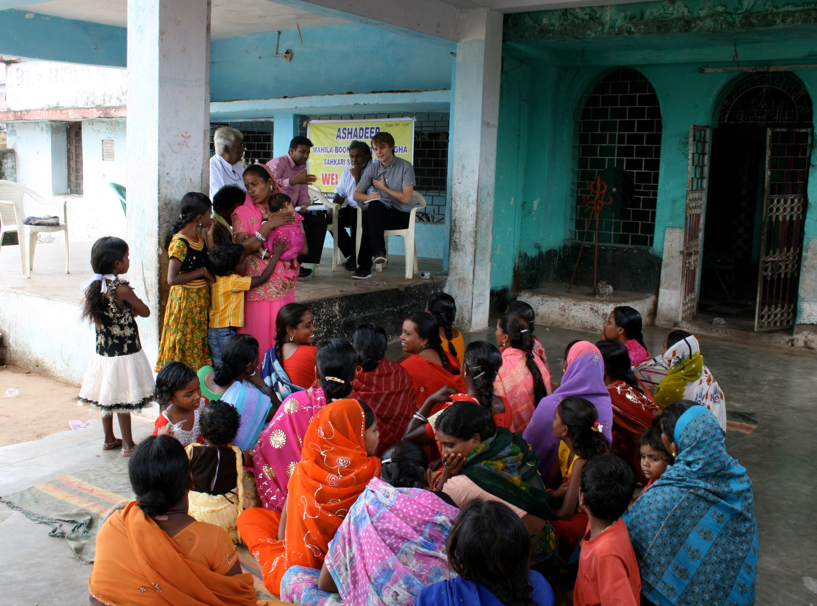
What do we mean by religious literacy?
Notes:
An understanding that beliefs and religious actors play a significant role in shaping society,
and our ability to relate to and work with these ideas and actors.
(note: from SMC policy on religious literacy)
We will explain further about religious literacy.

Slide 6
GENERAL
3 levels of religious literacy
CONTEXTUAL
PRACTICAL
Notes:
In this tools we will work at three levels. But in this short versin of the toolbox we will focus on the General religious literacy.
General religious literacy - Develop knowledge and reflection about religions role in rights-based development and what drives our own organisation.
Contextual religious literacy - Strengthen context and actor analysis through increased religious literacy.
Practical religious literacy - Identify relevant strategies in relation to religion and religious actors.

Slide 7
RELIGIOUS IDEAS AND ACTORS
FREEDOM OF RELIGION OR BELIEF (FORB)
OURSELVES
Notes:
We can look into religious literacy in 3 streams:
Religious ideas and actors
Ourselves and our identity
Freedom of Religion or Belief (FoRB)

Slide 8
What did we learn about development, 20 years ago
at university?
TRADITIONAL
RELIGIOUS
RURAL
SUBSISTANCE
DEVELOPED
URBAN
EDUCATION
SPECIALIZED
KNOWLEDGE
Notes:
There was an idea within development, that the importance of religion would fade away as people got more and more developed. This was a very euro-centric approach. On the contrary, religion ha become more and more visual in public sphere the last twenty years. Politics and religion are more and more intertwined. On all continents. Post the cold war, the big conflict lines are not, at least not on the surface, political or ideological but often religious. The words on the slide are taken from a lecture on development twenty years ago (late nineties) to illustrate a traditional society's transformation through development.

Slide 9
Notes:
The world is religious:
Bilingualism
Actors that have capacity to utilize both relevant religious language and theological awareness AND human rights language and theory, often have a higher capacity to choose among several available strategies and to navigate the context in an agile way.
However, religious belonging is not a guarantee for religious literacy. Also general contextual religious literacy is not necessarily a guarantee for ”religious fluency” in several religions. Religious fluency is like with any language – you are most fluent in your own mother tongue. If you are a Christian you will most probably be more fluent in how Christianity potentially relates to human rights rather than in how Islam potentially relates to human rights. Important to be humble and curious!

Slide 10
Language of development
IMPLEMEN-TATION
BACKDONOR
DONOR
Language of faith
Notes:
Back donors are usually secular government agencies and use a secular language of development. This language seems to follow the money, creating a ”development room” where a secular language is spoken even if donors and partner organisations are faith-based. Research has shown that the secular language of back donor seems to permeate the language of cooperation. Project proposals, evaluations and reports are written in the language of secular development agencies.
Many practitioners have an experience of leaving their own language of faith outside the “development room” in an attempt to “be professional”.
If the ability to speak the language of faith is lost, one dimension in cooperation is lost. Many faith based donor organisations are so used to tone down their faith based identity, in communication with government bodies, that their identity is altered and the bilingualism is lost.

Slide 11
Exercise:
Secularism?
Religion?
Notes:
The world is religious:
In pairs: interview each other on the following issues– 10 min See the next slida
What is religion?
What is secularism?
In what situations and in relation to what kinds of questions do you relate to religious actors or ideas during a every day work week?
Do a brief harvesting from each couple – note the answers on flipcharts (potentially pre-marked with ”substantive definitions” ”functional definitions” ”other” ”state non identification” ”secular separation” and ”Laicité”)
Bring the exercise together by commenting on different definitions of religion and secularism and the need for an adaptive usage of definitions depending on context and subject matter. Introduce different concepts of secularism and a critically explorative approach towards western secularism as neutral of values.

Slide 12
Exercise:
What is religion?
What is secularism?
In what situations and in relation to what kinds of questions do you relate to religious actors or ideas during an every day work week?

Slide 13
What is religion?
Spirituality
Ethics
Theology
Identity
Notes:
What is religion? Another way to look at different aspects of religion.
Spiritual- the personal level between me and a deity or spiritual realm
Theology – the public or shared part of spirituality- also making it possible to look at religion from the outside.
Ethics- the results of the above in values and actions
Identity- the shared collective values. Bordering politics.

Slide 14
”An organised collection of beliefs,
cultural systems, and world views that relate humanity to an order of existence. Many religions have narratives, symbols, and sacred histories that are intended to explain the meaning of life and/or explain the origin of life or the universe. From their beliefs about the cosmos and human nature, people derive morality ethics, religious laws or a preferred lifestyle (Wikipedia)
Notes:
What is religion?
So what is religion? That's an incredibly complicated question, and the answer will depend on whether you are asking from a theological, sociological, philosophical, cultural or legal perspective. Here is one definition
If possible, give the text as an handout and read out loud.

Slide 15
4
Notes:
4 principles on the following four slides
What is religion?
Four principles that can help understand religion as a societal phenomena.
They seek to address some of the most common misunderstandings about religion.
(Adapted from The Harvard University Religious Literacy Project website.)

Slide 16
A difference between confessional theology and the study of religion
Notes:
What is religion?

Slide 17
2. Religions are internally diverse
Notes:
What is religion?

Slide 18
3. Religions evolve and change
Notes:
What is religion?

Slide 19
4. Religious influences are embedded in cultures
Notes:
What is religion?

Slide 20
A difference between confessional theology and the study of religion
2. Religions are internally diverse
3. Religions evolve and change
4. Religious influences are embedded in cultures
Notes:
What is religion?

Slide 21
SMC:s view of religious literacy
Notes:
Religious literacy
General religious literacy
Contextual religious literacy
Human rights literacy in relation to FoRB.
Practical religious literacy
For SMC…
General religious literacy: the general understanding and acceptance that religion is an important factor in all social development which needs to be brought into the equation without either exaggerating or diminishing its importance as a factor. Also about actually having religious knowledge. What are the basic tenants of relevant religions or the basic traits of non-religious world views?
Contextual religious literacy: bringing your religious literacy into the context where you are positioned? What are the basic religious/faith tenants of the religious groups where you are situated? What are the different nuances in religious practice? Who are the religious groups around you and what are their internal and external relations to other sociatal actors? What religious or non-religious ideas are important for people in general and how do they influence their behavior and their relations with each other? Are there power dynamics that come into play? How does religion and other social phenomena such as e.g. culture, tradition, politics, ethnicity interact in what is happening in the context? What forces are instrumentalized by whom and for what purposes?
A contextual religious literacy will demand analysis of the context, its actors and of your own organization and its religious or non-religious identity in relation to all of this.
FoRB and human rights literacy: having a correct basic understanding of what rights FoRB gives to individuals and religious organisations (FoRB is often a very misunderstood human right) AND whether the context you are situated in actually allows for freedom of thought, religion and conscience? I.e. to what extent can religious, non religious actors and individuals actually operate freely? Are there agents in the context that abuse FoRB and the language of FoRB in order to promote their own agendas? How does the status for FoRB in the context affect other human rights – government restrictions and social conflict?
Practical religious literacy: the ability to practically apply general and contextual religious literacy in the context where you are working.
- Practical know how on e.g. human rights based interreligious dialogue and cooperation
Development and application of suitable strategies: Depending on your organisational identity, contextual analysis and your goals you might come to different conclusions as to what is the best strategy moving ahead. Taking such strategic decisions intentionally and developing the right method and practice as a result. We will come back to those strategies later. Key message here: without religous and FoRB/HR litteracy it is more difficult to make informed and intentional choices and monitor their impact.

Slide 22
Why do we need religious literacy?
What are the arguments?
Notes:
So now, let us dig deeper into general religious literacy
The world is religious…
So what does the world look like and why do we need religious literacy?
What are the arguments?
The world is religious! Religion is an important factor in all social development which needs to be brought into the equation without either exacerbating or diminishing its importance as an actor. Religion affects humans, groups, societies, communities and our relationship to the rest of nature – in all countries.

Slide 23
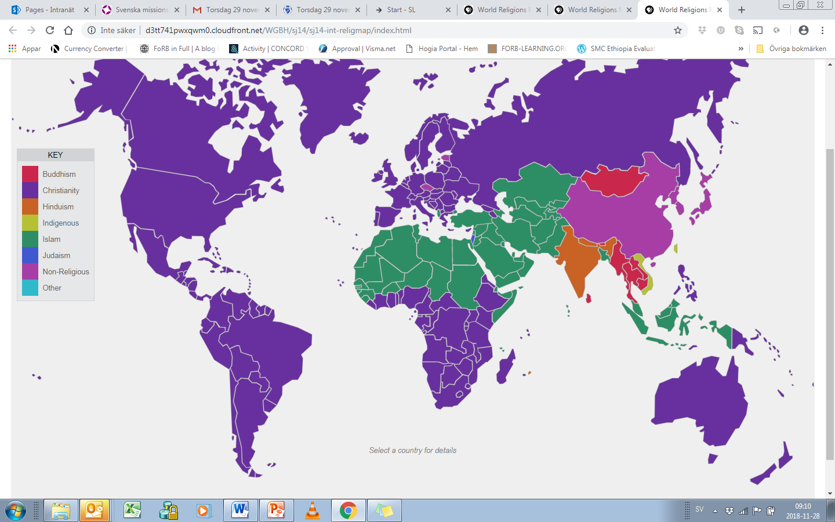
Notes:
The world is religious
The Conventional Picture
Interactive map with religious affiliation http://d3tt741pwxqwm0.cloudfront.net/WGBH/sj14/sj14-int-religmap/index.html
Data från Pew 2010

Slide 24
2015
84%
Notes:
The world is religious
Percent of the world’s population that define themselves as adhering to a religion.
This is maybe obvious in many countries, but not in Sweden.
In saying that the world is religious is however important to consider who it is that is making the definitions.
Here statistics for religious as an identity marker and potentially an objective classification rather than a subjective one
To what extent does self-announced religious affiliation actually impact on people’s every day lives in different contexts?
What does it mean to consider one-self as Christian in Sweden cf. China?
Does it matter if it is the state or another external actor that defines one’s religious identity or if it is me as a person?
Does everyone have the right and the actual possibility to state what religion or world view they adhere to?
Will religion continue to play a role in my life even if I’m e.g. an Indonesian atheist?
Keep these questions in mind as we proceed.
Source: ”The Changing Global Religious Landscape” PEW Research Center, 2017

Slide 25
2015
2060
84%
87,5%
Notes:
The number of persons affiliated with a religion is expected to increase. Mostly because populations in countries with strong religiosity have greater population growth.

Slide 26
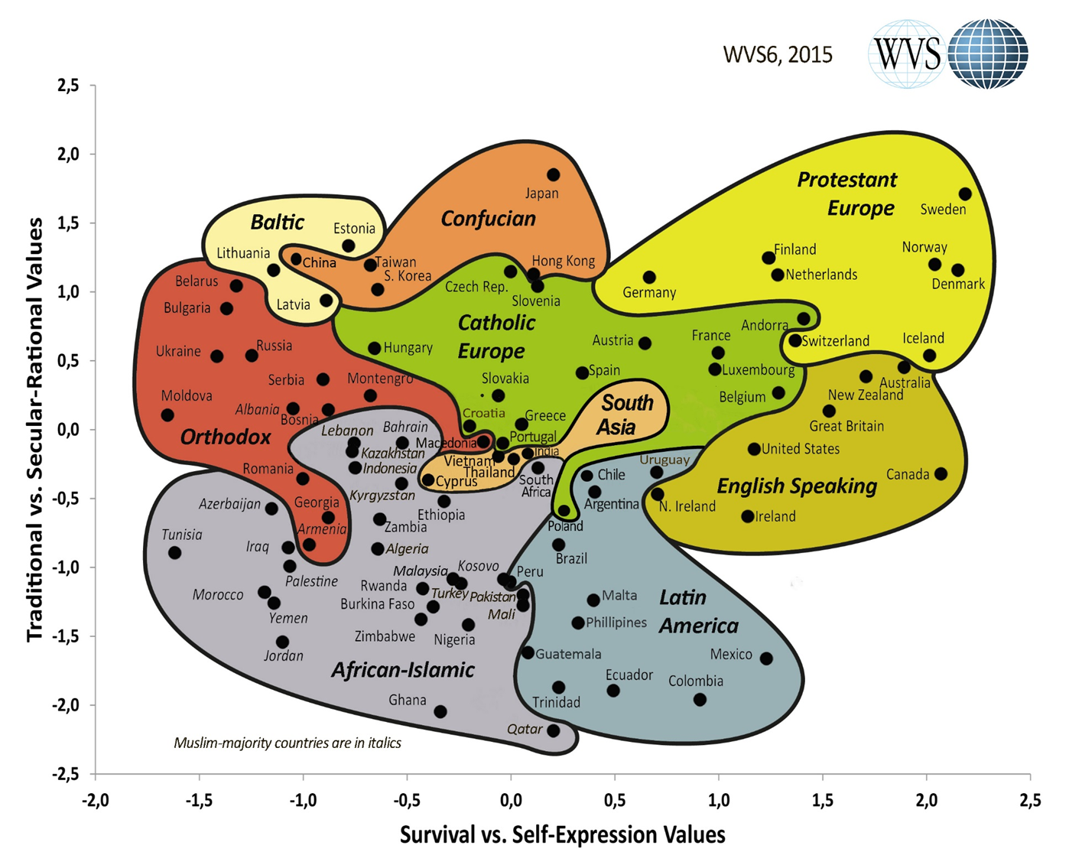
Values matter
Notes:
Why is religious literacy important?
Values matter.
Global development and the human rights agenda is based on values. Swedish development cooperation is based on values. And peoples values are shaped by the narratives trough which they interpret the world. Which glasses ae used, which grand narratives are utilized in different parts of the world. Religion is definitely important.
# The cultural map as presented by the World Values Survey would probably agree, with Sweden put in the corner, as the most secularized and least traditional country...
However, the reality is much more complex which was shown in a recent study by a Swedish scholar (David Thurfjell, The godless people). Two things are worth mentioning:
The Swedish secularisation process might be slightly exaggerated, partly due to the fact that this is told in a context influenced by the anti-religious and political circles, where we can trace a “religious illiteracy”.
There is an ambiguity in secular post-Christian Swedes’ way of speaking about religion and themselves; there is a discrepancy in what post-Christian Swedes actually believe and the idea they have about themselves.
In conclusion: even though secularization has gone far in Sweden, the image of Swedish society as a “de-christianed” and secularized country is being greatly exaggerated.

Slide 27
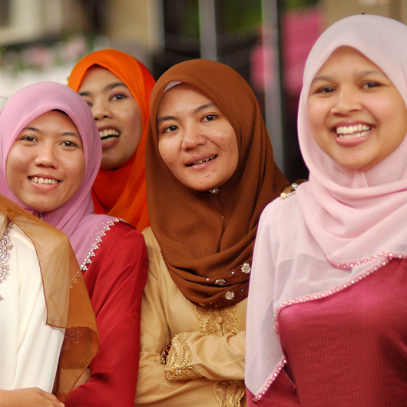
The world is complex…
…and religion and
identity are complex
Notes:
Remember that people more often than we think have
Multiple identities – in reality individuals might identify themselves as having many different worldviews or religions. In Sweden there is recent research showing that Swedes more and more patchwork their religous identities together from a number of different religous and non-relgious sources – not always being coherent with each other. Example of young suicidal girls refering to Budhist ideas of reincarnation when asked for their motives – post modernism at its height. People who have grown up in multuireligious settings where different cultural and religious identities are mixed. Internal identity – different of externally expressed identitites.
The Mixtures of different community characteristics.
Are not always as intellectually reflected in their faith as essentialist religious definitions would have it – see example above
Religion a complex phenomena in itself – one definition of religion will not suffice

Slide 28
Exercise:
To look at religion from an outside perspective?
Notes:
Discuss if it is a problem to talk about religion from an outside perspective. Why are we sometimes embarrassed? What reasons are there to avoid religion as a topic of conversation? Is it problematic for a devout believer to distance themselves from faith and try to look at it as a phenomena? Do I carry prejudice against other’s capacity to look at their faith from the outside?
How can we have a professional attitude towards religion- even our own faith?

Slide 29
https://youtu.be/AwAirRUjEHQ
Notes:
Här ska filmen six lenses ligga
A film on six different ”lenses” through which you can see religon.
The following eight slides can be used if the film does not work and can be skipped if the film is shown. The slides can also be used as a recap of the film for discussion.
Here is the script for the film:
In this short film we’re going to present six different lenses we can use to look at religion:
Lens number 1. A vertical approach
When we think about religion we usually think in terms of different religions - Christianity, Islam Hinduism, Judaism, Buddhism and so on. This is one useful way to categorise religious belief, practice and tradition. Religions do have major internal differences, with sometimes vicious intra-religious disputes, but they are held together by central beliefs or practices they share.
When we understand religion in these terms, our religious literacy will tend to focus on what 'each religion' believes and central practices. It's good to understand the typical core elements of religions. At the same time it's important to remember that within any given religion you will find groups and individuals that don't believe what you've been taught.
Thinking of the different religions as distinct units is not the only or necessarily the most helpful way to think. It can lead us to make generalisations and assumptions about the people around us instead of approaching them as individuals, and to seeing religions as monolithic, static blocs instead of the diverse and dynamic organic bodies they are.
Let's explore some complementary ways of understanding religion that can be helpful.
Lens number 2. Correct beliefs versus correct practice (Orthodoxy v. orthopraxy)
Most religious traditions include both beliefs and practice, but within one and the same religion different traditions place a different degree of importance on beliefs and practice. Within the Christian tradition, Protestantism has a strong focus on having the 'right' beliefs, whilst the Orthodox tradition focuses much more strongly on the practice of the liturgy.
Lens number 3. Inner experience versus outward behaviour (Esoteric v. exoteric)
Of course religions all include elements of both inner spiritual experience and outward behaviour, but some religions like Christianity, Islam and Judaism are usually described as having a stronger outward focus, while Hinduism and Buddhism are usually described as having a greater focus on inner experience. Once again, the balance between these two elements varies enormously between different traditions within any given religion and between individuals within these traditions. For example, Pentecostalism has a strong focus on feelings and experiencing spiritual gifts.
Lens number 4. Isolationist versus publicly engaged and absolutist versus relativist
The degree to which religious communities engage in public life and the degree to which they are absolutist or relativist varies tremendously within religions. By absolutist, we mean that a group that thinks their beliefs and practices alone are absolutely true and correct, to be followed without compromise in all situations. By relativist we mean people/groups who think that your truth is true for you, my truth is true for me.
The following tendencies can be found within all major religions and form a spectrum.
Absolutist: People and groups with this approach regard all others as lost or damned, including or especially those who differ within their own religion. These groups may be peaceful, perhaps isolating themselves from society-at-large, or engaged but confrontational, aggressively imposing their beliefs and practices on others through coercion, threats or even violence.
Exclusivist: People and groups with this approach accept or tolerate differences among their own but insist, often assertively, on their particular correctness. Other religions are considered to be untrue. They may or may not be socially engaged, but often engage in peaceful religious persuasion. Sometimes exclusivists are accused of coercion – for example, when religious persuasion takes place in connection with the distribution of disaster relief.
Tolerant: People and groups in with this approach think their beliefs are the truth, but accept that others disagree and don’t seek to change their minds. They may or may not engage in dialogue and cooperation with others.
Relativist: People or groups with this approach suspend judgment on the correctness of belief - ‘All roads lead to God’. They often welcome cooperation and dialogue both within and between religions.
Of course, this is a simplification! For example, some relativists are deeply intolerant of people who are do not accept relativism.
Lens number 5. Centralised versus de-centralised
When it comes to how centralised decision-making, leadership and organisational structures are, there is enormous variation within religions. The Roman Catholic Church is highly centralised, whilst the Pentecostal movement is highly decentralised. Within Shia Islam, Ismailis have a centralised structure with a single hereditary leader (the Aga Khan) whilst the 'twelver' branch of Shia Islam is far less centralised.
People’s ideas about religious power and religious structures of authority often influence their ideas about how political and social power should be exercised, as well as people’s willingness to accept or question power holders. And different traditions within the same religion can have very different approaches to how they should interact with the state or other power holders. Theological ideas can also influence people’s ideas about how change happens – does it come from below or above?
Lens number 6. Religion as community
For a great many people their appreciation of religious belief and practice links closely to their appreciation of the religious community to which they belong. Religion can be regarded as community in many different ways
as a community of worship, where the collective performance of rituals renews and restates a shared worldview
as a community of allegiance or loyalty to a (human) religious authority
as a community of inter-dependency, for example when the religious community share resources and care for one another or
as a community of dependency, when control over resources is held by political power legitimised by religious hierarchy
For many if not most people, religious belief, practice, tradition, culture or community are an important part of their personal identity. It is part of what defines who they are: their self-perception and the way others perceive them.
Some people perceive religion as a community of chosen identity – in which each member has actively chosen to accept beliefs, practices and belonging.
But for many people religious identity is a communal identity with cultural and often ethnic identities interwoven. In fact, many people consider themselves to have a religious identify and to be part of a religious community, even though who don't actively believe or practice their religion. This is known as belonging without believing.
Perceiving religion as identity can sometimes be problematic. In some contexts, majority society or the state regards the majority religious identity as being synonymous with national identity. This usually creates problems for citizens who don't share that identity, particularly if they have left the majority religion for atheism or another religion. In some contexts these people are regarded as disloyal or a threat to the nation.
So there are many different ways of understanding religion as community – and these different understandings often overlap.
Using these six lenses to look at religion helps us understand religion in ways that cut across traditions. The point of this is NOT to say that all religions are the same, or to say anything at all about how true or good my or your religion or belief is.
The point of the lenses is to help us understand the different roles religion plays in people’s lives and in society, and to help us to meet others with openness – seeing the person or local community concerned, instead of the pre-conceived labels and stereotypes so often attached to them.
REFLECT When you reflect on your own religious tradition, can you recognise the kinds of diversity represented in the 6 lenses above?

Slide 31
Notes:
Lens number 1. A vertical approach
When we think about religion we usually think in terms of different religions - Christianity, Islam Hinduism, Judaism, Buddhism and so on. This is one useful way to categorise religious belief, practice and tradition. Religions do have major internal differences, with sometimes vicious intra-religious disputes, but they are held together by central beliefs or practices they share.
When we understand religion in these terms, our religious literacy will tend to focus on what 'each religion' believes and central practices. It's good to understand the typical core elements of religions. At the same time it's important to remember that within any given religion you will find groups and individuals that don't believe what you've been taught.
Thinking of the different religions as distinct units is not the only or necessarily the most helpful way to think. It can lead us to make generalisations and assumptions about the people around us instead of approaching them as individuals, and to seeing religions as monolithic, static blocs instead of the diverse and dynamic organic bodies they are.
Let's explore some complementary ways of understanding religion that can be helpful.

Slide 32
Notes:
Lens number 2. Correct beliefs versus correct practice (Orthodoxy v. orthopraxy)
Most religious traditions include both beliefs and practice, but within one and the same religion different traditions place a different degree of importance on beliefs and practice. Within the Christian tradition, Protestantism has a strong focus on having the 'right' beliefs, whilst the Orthodox tradition focuses much more strongly on the practice of the liturgy.

Slide 33
Notes:
Lens number 3. Inner experience versus outward behaviour (Esoteric v. exoteric)
Of course religions all include elements of both inner spiritual experience and outward behaviour, but some religions like Christianity, Islam and Judaism are usually described as having a stronger outward focus, while Hinduism and Buddhism are usually described as having a greater focus on inner experience. Once again, the balance between these two elements varies enormously between different traditions within any given religion and between individuals within these traditions. For example, Pentecostalism has a strong focus on feelings and experiencing spiritual gifts.

Slide 34
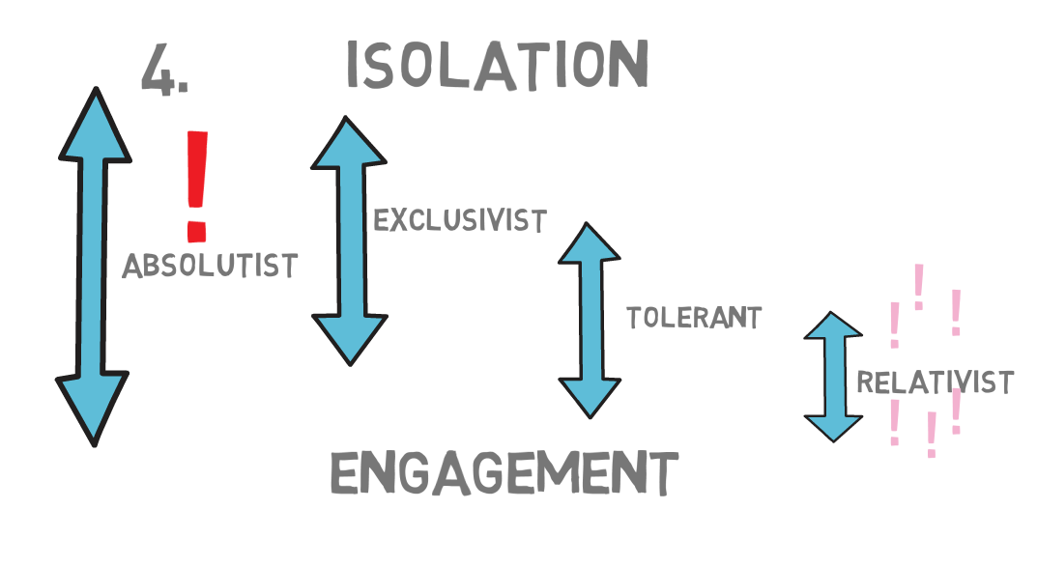
Notes:
Lens number 4. Isolationist versus publicly engaged and absolutist versus relativist
The degree to which religious communities engage in public life and the degree to which they are absolutist or relativist varies tremendously within religions. By absolutist, we mean that a group that thinks their beliefs and practices alone are absolutely true and correct, to be followed without compromise in all situations. By relativist we mean people/groups who think that your truth is true for you, my truth is true for me.
The following tendencies can be found within all major religions and form a spectrum.
Absolutist: People and groups with this approach regard all others as lost or damned, including or especially those who differ within their own religion. These groups may be peaceful, perhaps isolating themselves from society-at-large, or engaged but confrontational, aggressively imposing their beliefs and practices on others through coercion, threats or even violence.
Exclusivist: People and groups with this approach accept or tolerate differences among their own but insist, often assertively, on their particular correctness. Other religions are considered to be untrue. They may or may not be socially engaged, but often engage in peaceful religious persuasion. Sometimes exclusivists are accused of coercion – for example, when religious persuasion takes place in connection with the distribution of disaster relief.
Tolerant: People and groups in with this approach think their beliefs are the truth, but accept that others disagree and don’t seek to change their minds. They may or may not engage in dialogue and cooperation with others.
Relativist: People or groups with this approach suspend judgment on the correctness of belief - ‘All roads lead to God’. They often welcome cooperation and dialogue both within and between religions.
Of course, this is a simplification! For example, some relativists are deeply intolerant of people who are do not accept relativism.
Lens number 5. Centralised versus de-centralised

Slide 35
Notes:
Lens number 5. Centralised versus de-centralised
When it comes to how centralised decision-making, leadership and organisational structures are, there is enormous variation within religions. The Roman Catholic Church is highly centralised, whilst the Pentecostal movement is highly decentralised. Within Shia Islam, Ismailis have a centralised structure with a single hereditary leader (the Aga Khan) whilst the 'twelver' branch of Shia Islam is far less centralised.
People’s ideas about religious power and religious structures of authority often influence their ideas about how political and social power should be exercised, as well as people’s willingness to accept or question power holders. And different traditions within the same religion can have very different approaches to how they should interact with the state or other power holders. Theological ideas can also influence people’s ideas about how change happens – does it come from below or above?

Slide 36
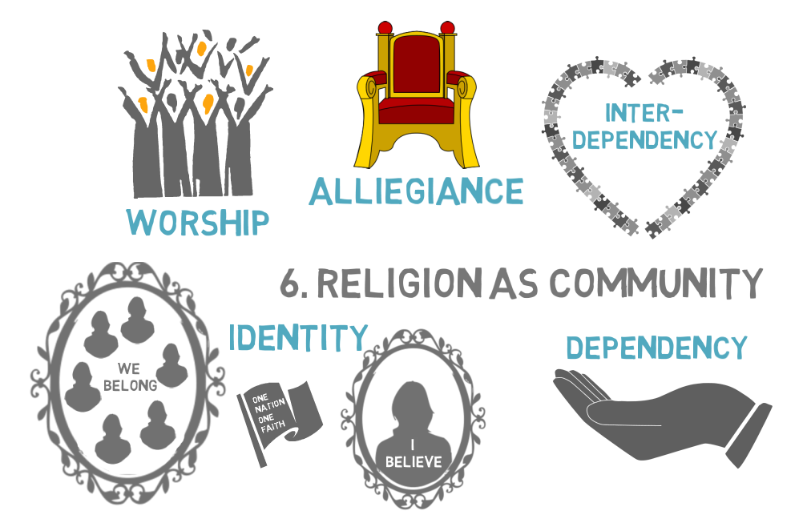
Notes:
Lens number 6. Religion as community
For a great many people their appreciation of religious belief and practice links closely to their appreciation of the religious community to which they belong. Religion can be regarded as community in many different ways
as a community of worship, where the collective performance of rituals renews and restates a shared worldview
as a community of allegiance or loyalty to a (human) religious authority
as a community of inter-dependency, for example when the religious community share resources and care for one another or
as a community of dependency, when control over resources is held by political power legitimised by religious hierarchy
For many if not most people, religious belief, practice, tradition, culture or community are an important part of their personal identity. It is part of what defines who they are: their self-perception and the way others perceive them.
Some people perceive religion as a community of chosen identity – in which each member has actively chosen to accept beliefs, practices and belonging.
But for many people religious identity is a communal identity with cultural and often ethnic identities interwoven. In fact, many people consider themselves to have a religious identify and to be part of a religious community, even though who don't actively believe or practice their religion. This is known as belonging without believing.
Perceiving religion as identity can sometimes be problematic. In some contexts, majority society or the state regards the majority religious identity as being synonymous with national identity. This usually creates problems for citizens who don't share that identity, particularly if they have left the majority religion for atheism or another religion. In some contexts these people are regarded as disloyal or a threat to the nation.
So there are many different ways of understanding religion as community – and these different understandings often overlap.

Slide 37
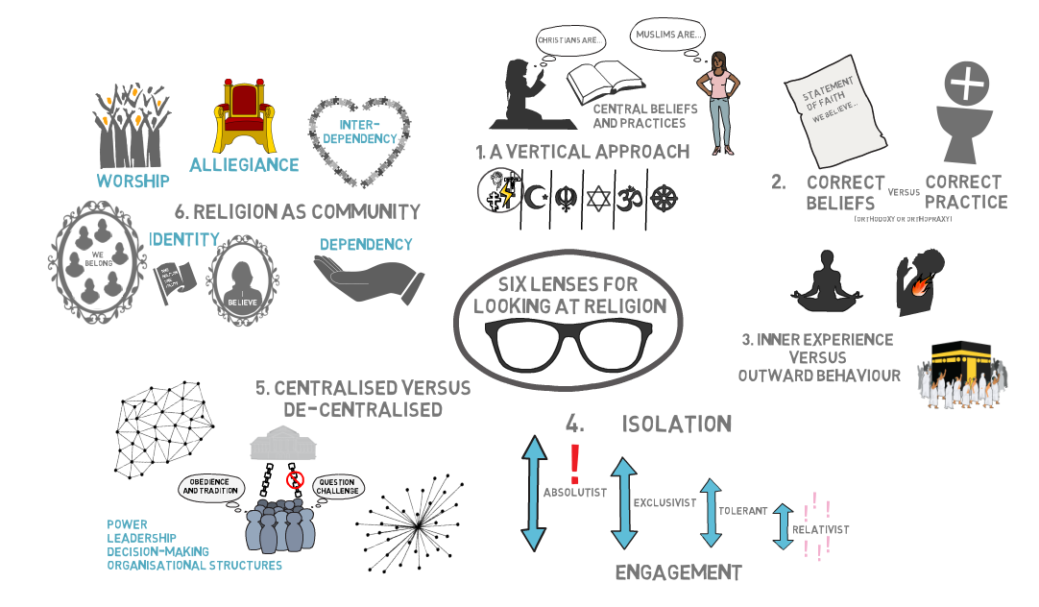
Notes:
Using these six lenses to look at religion helps us understand religion in ways that cut across traditions. The point of this is NOT to say that all religions are the same, or to say anything at all about how true or good my or your religion or belief is.
The point of the lenses is to help us understand the different roles religion plays in people’s lives and in society, and to help us to meet others with openness – seeing the person or local community concerned, instead of the pre-conceived labels and stereotypes so often attached to them.
REFLECT When you reflect on your own religious tradition, can you recognise the kinds of diversity represented in the 6 lenses above?

Slide 38
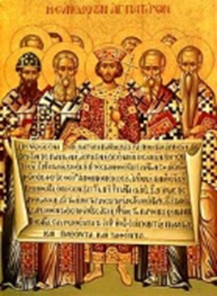
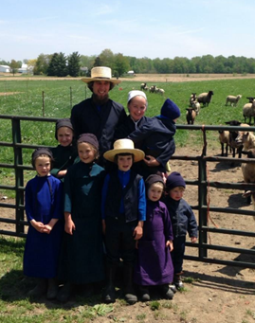
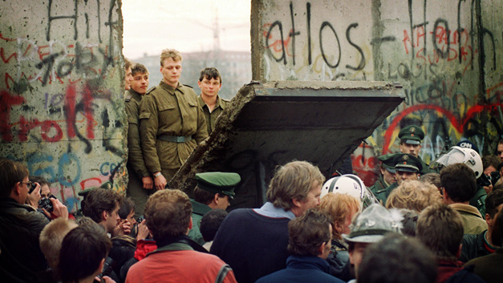
Change from top to bottom
Structural issues
Individual issues
Change from
bottom to top
Notes:
A part of religious literacy is to understand how theology and social action is interlinked. Different faith groups chose totally different approaches to societal change often based in their theology. In the Christian tradition this goes back to the early church and the different approaches to the government that the church has taken over history.
The slide refers to two axels where a top-bottom or bottom-top approach to societal change is taken and where the focus on change is either on the personal or the collective/societal. Different religious groups could be place differently in this graph.
This slide is applicable in a Christian context and categorizes different actors by their approach to societal change. It gives an overview of four different approaches to societal change frequently used within the Christian tradition.
Another way to describe this within the Christian tradition is to point to four different approaches to societal change within history.
1. Unite with power or seize power! When the church tries to take power, the church is sometimes more affected than the “power” or empire they are trying to change. Historic examples are Emperor Constantin, Calvin or the state churches throughout Europe. These examples all indicate that the power structures had more influence on the church than vice versa.
2. The diaconal way, avoiding politics at any cost, but trying to change society through good deeds and individual improvement. This approach has historically shown a big risk in missing out on structural injustice but have nevertheless had great impact on society.
3. Not seeking impact on wider society but instead trying to realize “the kingdom of God” within your own group. Compare with Mennonites or parts of monastic tradition. These movements might have had more impact on society than expected, considering their exclusive nature.
4. Great sustainable political and societal change is often built on spiritual inspiration, non-violence and mass movements. This process might need a catalyst. Applicable where the specific faith is in majority but not necessarily in line with the powers. Compare the fall of the Berlin wall or South Africa in the 90s.)
The images in the graph shows emperor Constantin, the fall of the Berlin wall and an Amish family.

Slide 39
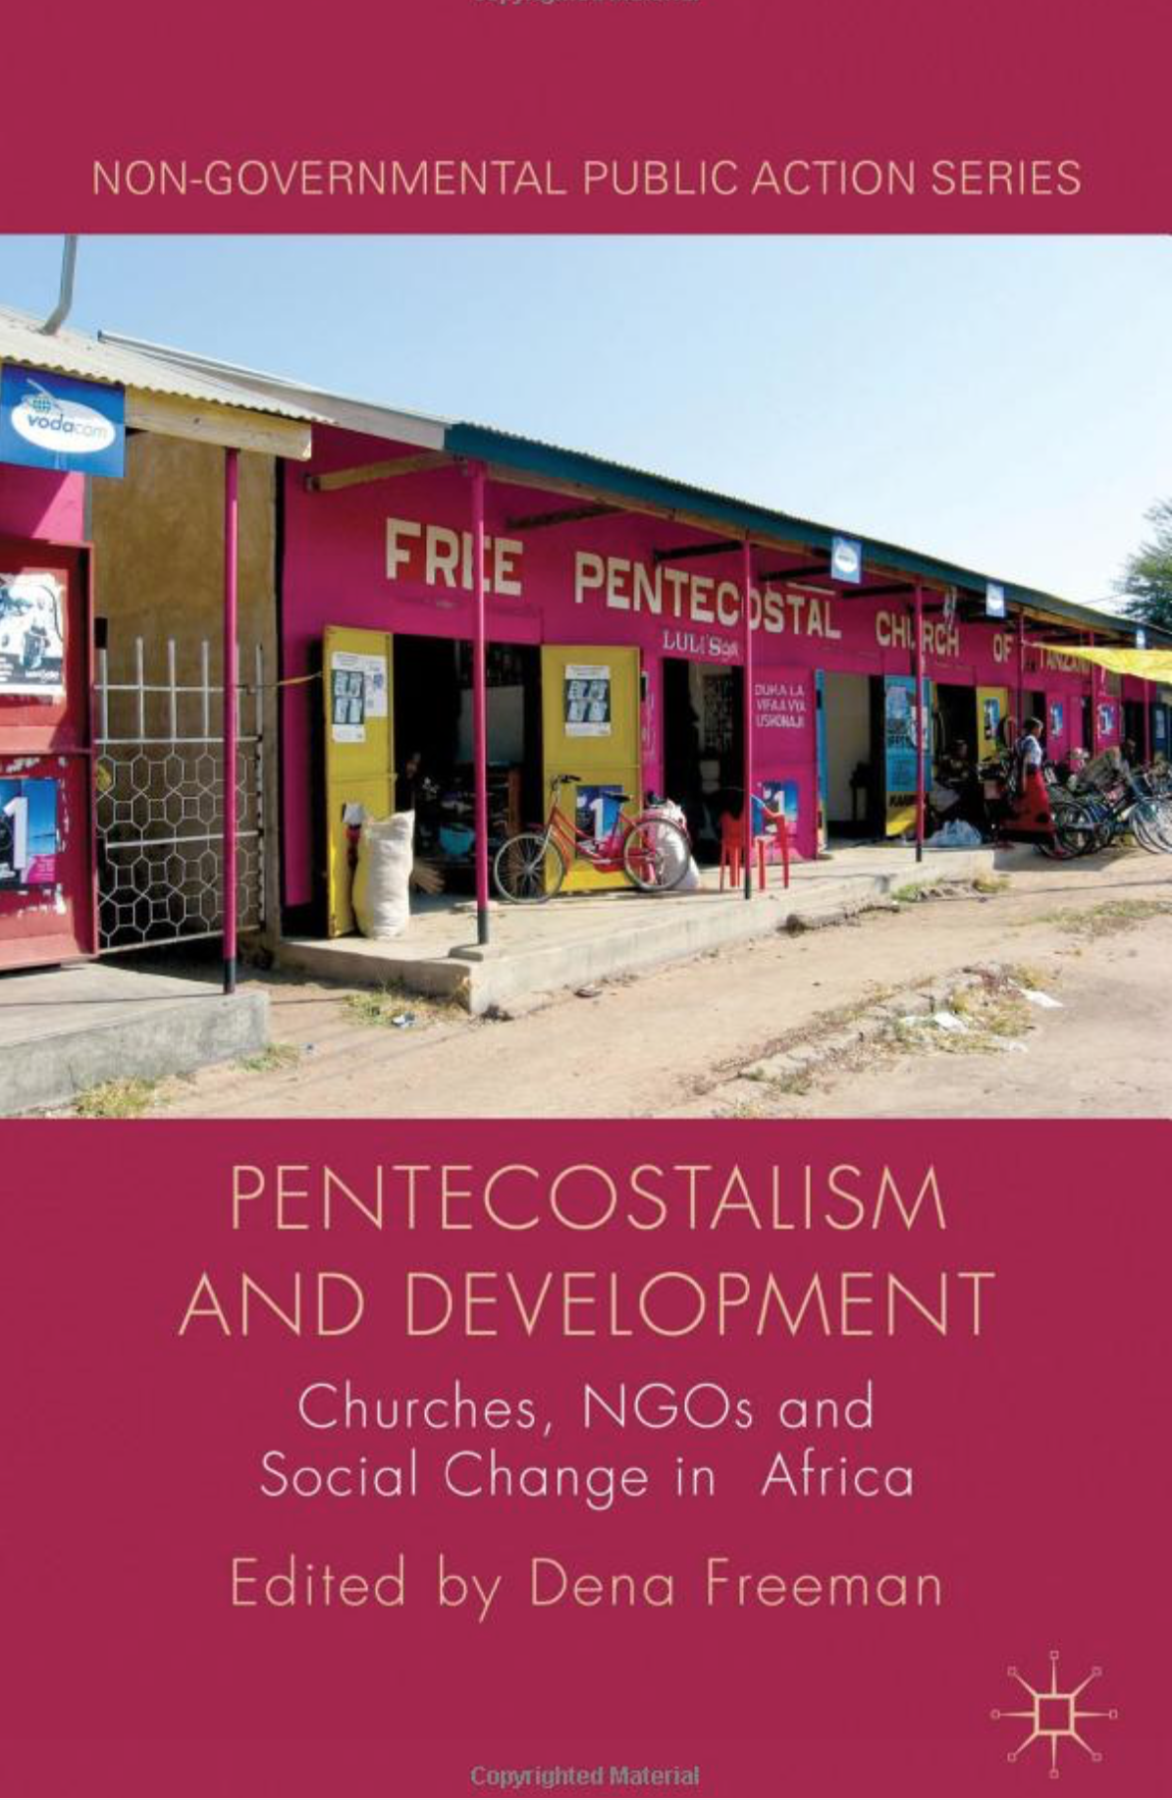
Religion motivates…
Notes:
… people (and societies) to change, strengthens resilience and is a strong contributor to a sense of purpose.
HOPE, RECONCILIATION, ENERGY AND MOTIVTIONAL DRIVE FOR CHANGE.
E.g. Truth and reconciliation commissions that are often led by religious leaders
E.g. the global Pentecostal movement (see quote)
“Pentecostal churches are often rather more effective change agents than are development NGOs…they are exceptionally effective at bringing about personal transformation and empowerment, they provide the moral legitimacy for a set of behaviour changes that would otherwise clash with local values, and they radically reconstruct families and communities to support these new values and new behaviours. Without these types of social change…it is difficult for economic change and development to take place” (Freeman p.3).
”Pingstkyrkor är ofta mer effektiva förändringsaktörer än biståndsorganisationer… De är förvånansvärt effektiva på att orsaka personlig förvandling och självförtroende, de ger moralisk legitimitet för att förändra beteenden som annars skulle gå emot lokala värderingar, och de omskapar familjer och gemenskaper på ett radikalt sätt som stöder de nya värderingarna och beteenden. Utan dessa typer av sociala förändringar… så är det svårt för ekonomisk förändring och utveckling att ske”. (Freeman s.3).

Slide 40
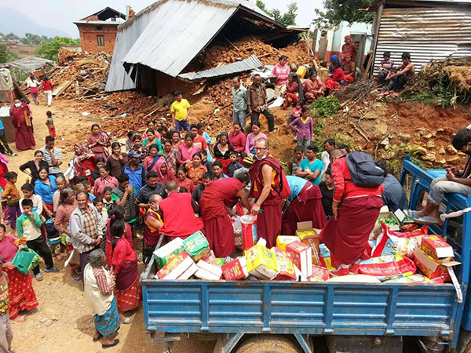
Faith based actors have…
Notes:
… legitimacy, networks, reach, efficiency, long term presence
Buddhist monks from Kopan monastery after the earth quake in Nepal 2015
Religious actors have legitimacy, networks, reach, efficiency and long- term presence.
E.g. health and educational institutions on a religious basis – ranching from health centers in Uganda to qualified madrasas in Pakistan
First responders within humanitarian work (e.g. the earth quake in Nepal - picture)
- Can be strong advocacy actors for through contacts at the grassroots level and access to political decision makers ands strong international networks (e.g. NCCI India - UPR 2016)

Slide 41
Religion and gender
Who have access to power trough religious organisations?
Who are the followers and believers?
Does religion have a positive or negative impact on gender equality?
Notes:
These questions are not easily answered. But it is clear that religion has a great impact on power structures also between different genders. It is also when it comes to issues of gender equality and sexual and reproductive health and rights that the development actors first identified the need to involve religious actors in their work. You will come back to issues about gender and religious actors when you start looking into contextual religious literacy.

Slide 42
For better, for worse…..
Notes:
There are numerous examples of religious actors having an negative impact on development or human rights. It takes some religious literacy to understand the often complex relation between politics and religion. The picture is from Uganda where the government supported by SOME religious representatives have pushed for stricter anti-LGBTI legislation. The other picture is a handbook in armed response to protect churches in the US. But besides these extreme examples religious literacy is needed to see that religious groups often have a complex political agenda that is different from a traditional right to left agenda. Some religious actors are very radical on social justice but conservative on women's rights. You may also find different opinions within the same religious body. The role of religion in conflicts is often debated. There are examples of religious actors promoting a conflict, but there are also many examples of conflicts emerging from socio-economic or political causes but for many reasons taking on a religious façade.

Slide 43
Instumentalization:
Who owns the agenda?
Notes:
Is there a risk in instrumentalizing religious actors for the agenda of a back donor? One example is when faith based actors have been rather keen to underline their own “added value” in development work, for example their reach and access to grassroots communities. Back donors have then seen religious actors as “easy”, effective and cheap instruments for the agenda of the back donor. This means that they have not totally understood the complex nature of faith based actors.
Can you think of examples of this in your own context?
This needs to be problematized. Religious actors cannot been seen as just messengers or instruments for a development agenda. Religious actors have their own agenda, in their own right.

Slide 44
Secular or Faith-Based?
Notes:
So we have established a case for the world being religious, and that engaging with religion is important for social change.
Now we move onto the second part of general religious literacy…
What about us? Are we religious?
Again this ‘traditional distinction’ might not be very helpful, as our reality is often far more complex.

Slide 45
Sider and Unruh’s FBO typology
1. Faith-permeated organisations
2. Faith-centred organisations
3. Faith-background organisations
4. Faith-secular partnerships
5. Secular organisations
Notes:
Organisational Typologies
Ronald J. Sider & Heidi Rolland Unruh, “Typology of religious characteristics of social service and educational organizations and programs”, Non-profit and voluntary sector quarterly 33, no. 1 (2004): 109-134.
1. Faith-permeated organisations, the connection with religious faith is evident at all levels of mission, staffing, governance and support.
2. Faith-centred organisations were founded for a religious purpose, remain strongly connected with the religious community through funding sources and affiliation, and require most staff to share the organisation’s faith commitments.
3. Faith-background organisations tend to look and act secular, although they may have a historical tie to a faith tradition.
4. Faith-secular partnerships present a special case in which a secular (or faith-background) entity joins with one or more congregations or other explicitly religious organisations.
5. Secular organisations have no reference to religion in their mission or founding history.

Slide 46
IDEA model
Declared identity:
WE SAY
Experienced identity:
WE FEEL
Attributed identity:
THEY SAY
Notes:
IDEA
Identify
Declared
Experienced
Attributed
One helpful way of thinking about organizational identity is to break it into three parts:
- what we officially say about the organization in policies, websites, constitutional documents, strategic plans etc.
- What we experience working in the organisation - how is it in reality!
- what others say about the organization? Who do they perceive that we are? (rightly or wrongly … “facts are facts, but perceptions are reality!”)
What different answers will we get if we ask about whether we are religious or secular, or about what drives and motivates our organisation?

Slide 47
IDEA model
Who are we in reality?
Declared identity:
WE SAY
Experienced identity:
WE FEEL
Attributed identity:
THEY SAY
Who do we say we are?
How do we want to be perceived?
Who are we in the eyes of others?
Notes:
One helpful way of thinking about organizational identity is to break it into three parts:
- what we officially say about the organization in policies, websites, constitutional documents, strategic plans etc
- What we experience working in the organization - how is it in reality!
- what others say about the organization? Who do they perceive that we are? (rightly or wrongly … “facts are facts, but perceptions are reality!”)
What different answers will we get if we ask about whether we are religious or secular, or about what drives and motivates our organisation?

Slide 48
Faith
Unmet Rights
Common enemy
Motivations?
Common Interest
Ideology
Security
Political mandate
Concern about vulnerable groups
Solidarity
Notes:
What drives our organisation?
There are many different factors which can motivate us to organise, or join organisations. Faith is one possible motivator. We are probably motivated by more than one issue.
…what about your organisation?
This is what we will explore through the model.

Slide 49
Discuss in organisation groups:
Who are we in reality?
Who do we say we are?
How do we want to be perceived?
Declared identity:
WE SAY
Experienced identity:
WE FEEL
Declared:
What do we express in our formal documents and our communication outward?
What typology would we use to describe us based on our formal documents and communication outwards?
Experienced:
How do we experience ourselves?
What typology would you use to describe the organisation?
Notes:
Internal perspective:
Exercise:
In organisation groups
Write up responses to each of the different parts of the IDEA model on separate large sheets of paper (A3 or bigger)

Slide 50
Discuss in organisation groups:
Attributed identity:
THEY SAY
Who are we in the eyes of others?
How do others perceive us? How have they described our organisation? Do they perceive us as religious?
Which FBO type would they assign to us?
Notes:
What drives our organization?
External perspective:
Exercise part 2 - continue on another sheet of paper

Slide 51
Is it in your policy?
Is it the staff?
Who is the guardian of your identity?
Motivations?
Is it the members?
Is it the Secretary General?
Is it in the Board?
Notes:
Discuss in groups, based on your reports on the big paper sheets about who is the owner, guardian or keeper of your identity? How is it in reality? How would you like it to be?

Slide 52
Discuss: Multi faith staff
Describe the situation in your own organisation!
How do you make use of this asset?
What is the relation between multi faith staff and organisational values.
Notes:
Many organisations have staff from different religious backgrounds. Are staff with different religious backgrounds or no religious beliefs, seen as an asset in religious literacy? How are their experiences used?
This is maybe a sensitive issue in your organisation.

Slide 53
Putting it together
Declared identity:
WE SAY
Experienced identity:
WE FEEL
Attributed identity:
THEY SAY
?
Notes:
How close do the 3 sheets correlate with each other?
When we look at the three rings, how well do they fit together and in what way do they differ?
What does this reveal to us about and our religious identity?
How well do we understand our religious identity? Is this something we need to work on further?

Slide 54
Notes:
Organizational anecdotes…
What narratives does your organisation carry to describe your identity? Share stories you love to tell about your organisation! As you identify these stories: who tells them normally? Who is the owner and the carrier of your identity? These stories might say more about your organisational identity than any policy or mission-statement.

Slide 55
What is FoRB?
Notes:
Now we move onto the third part of general religious literacy - the importance of freedom of religion and belief. A short film is presented in the next slide. FoRB or lack of FoRB sets the limits to how free we are to talk about religion and development. Limitations in FORB might effect the whole outcome of the discussion. As a facilitator you must of course be aware of such limitations in your group and context.
https://www.forb-learning.org
FORB Intro Video

Slide 56
https://www.youtube.com/watch?v=fy6z14GjO-4
Notes:
FORB film

Slide 57
What does freedom of religion or belief involve?
COERCION
DISCRIMINATION
NO!
Notes:
This slide can be used as a re-cap of the film or replace the film if it cannot be shown due to technical reasons.
This slide gives you the opportunity to talk freely about all the different dimensions of freedom of religion or belief and for people to ask questions about them.
Right to have or change
Right to manifest
Rights for parents and children
Ban on coercion
Ban on discrimination
Right to conscientious objection

Slide 58
OK, but why is FORB important?
Notes:
We need freedom to talk about religion and values…

Slide 59
Religious actors, FORB and social change
Notes:
The extent to which FoRB is realised or not in a specific context effects the ways in which religious actors cooperate or do not cooperate with formal or informal power-holders. The following four slides give four different examples of the complex relations between religious actors and the rulings powers in a society.

Slide 60
Religious actors are not always what they seem to be…
In line with power/majority
In open opposition to the rulers
Development or Human rights on surface- religious under the radar
Religious on the surface- HR under the radar
Notes:
Sometimes religious actors enforce the existing power structures. They might be a part of the state structure. They might be identified with the majority of the population. There could be many reasons for the support of religious actors to the power structures at hand.

Slide 61
Religious actors and social change
In line with power/majority
In open opposition to the rulers
Development or Human rights on surface- religious under the radar
Religious on the surface- HR under the radar
Notes:
Sometimes religious actors are in open opposition to the government or other power structures.
Sometimes this is a very complex matter where parts of a denomination supports the ruling powers and other parts of the same denomination is in opposition.

Slide 62
Religious actors and social change
In line with power/majority
In open opposition to the rulers
Development or Human rights on surface- religious under the radar
Religious on the surface- HR under the radar
Notes:
When FoRB is very limited, organisations might have a developmental or humanitarian agenda on the surface but a religious agenda in the hidden. This is very complex as a humanitarian work could be an expression of faith and have it’s own value in the eyes of the religious actor. Many religious organisations have a social wing, giving them freedom to operate in areas where evangelisation/preaching could not be possible. But is it really a hidden agenda or is it an integrated part of the belief system?

Slide 63
Religious actors and social change
In line with power/majority
In open opposition to the rulers
Development or Human rights on surface- religious under the radar
Religious on the surface- HR under the radar
Notes:
In context where the political freedom is very limited religious organisations might be a safe haven for HR-work or even more subversive actions. One example is Myanmar Institute of Theology in Yangon having a religious/theological identity during the military rule of Burma/Myanmar but more secretly training human rights defenders. Another example is western Christian organisations having missionaries in apartheid South Africa, in reality working with political issues.

Slide 64
Discuss in table groups:
Can we freely talk about norms and religion in our project areas?
What legal frameworks exist to protect FORB in the country?
Is there culture of freedom in relation to religion and belief in the country?
Give both positive and negative examples if possible
Notes:
Ask the group to share their stories. If the context is very restrictive and they represent a persecuted minority, formulate this as positive stories. Most likely the bad stories will come indirectly.

Slide 65
Summary General religious literacy
Notes:
Combination of
- understanding the role of religion in the world,
- an understanding of who we are - what motivates us - from a religious perspective
- and recognition that religion and values lie beneath our behaviours and structures, and so we need freedom to talk about religion and values in order to be able to change society.

Slide 66
How have you already answered these questions:
3
Notes:
To what extent have you already integrated these perspectives into your existing analysis?
Decide which situation/context you are focusing on. Choose one relevant and practical case!
This is very important for the rest of the training. The context or the examples chosen here will be important forward as cases used in discussions.

Slide 67
1. What religious actors and ideas are at work in our context?

Slide 68
2. How well do we understand these religious actors?

Slide 69
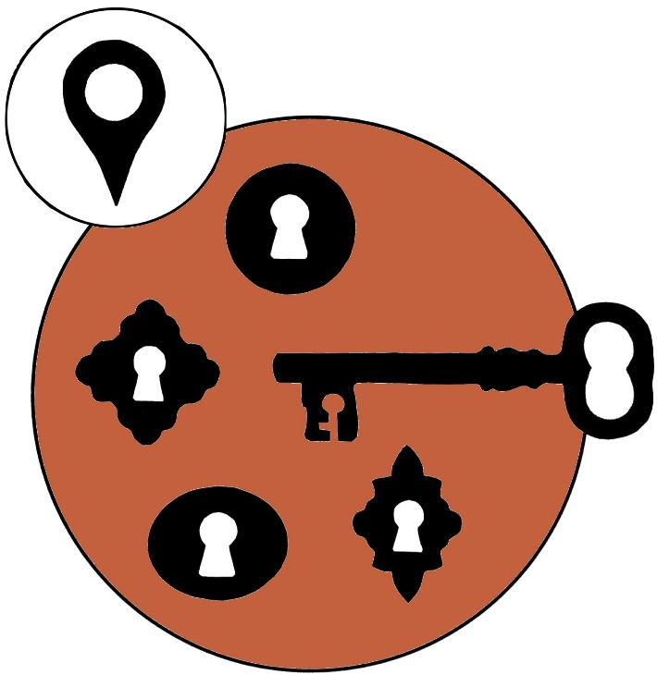
3. Does the context allow us to ask questions about religion and belief?

Slide 70
Illustrations: © Majsan Sundell Page 5, 10-22, 26-27, 29, 44-45, 65, 76-77, 81, 89, 93-98, 107-108, 117-120, 127-134, 137
Notes:
Illustrations: © Majsan Sundell (Slides 5, 10-22, 26-27, 29, 44-45, 65, 76-77, 81, 89, 93-98, 107-108, 117-120, 127-134, 137)
Main illustrations: Majsan Sundell
Project leaders: Phil Smith, Lisa Minnhagen and Petter Jakobsson
For more information please contact Petter Jakobsson petter.jakobsson@smc.global

