Slide 1
The Local Changemakers Course

Slide 2
SESSION 5
Freedom of religion or belief
in our community
Notes:
Welcome everyone to the session.
Introduce the session by explaining the following:
In the last 3 sessions we looked at the human right to freedom of religion or belief. We’ve learnt about the rights we have and the different types of violations that can occur. We’ve also reflected on what this human right means to us and explored issues of identity, privilege, and disadvantage.
In this session, we are going to focus on analysing our own context to identify what problems different people or groups might face. We are going to do that by creating a visual Freedom of Religion or Belief ‘map’ of our town together. But before we start looking at problems, let’s think about the good things!

Slide 3
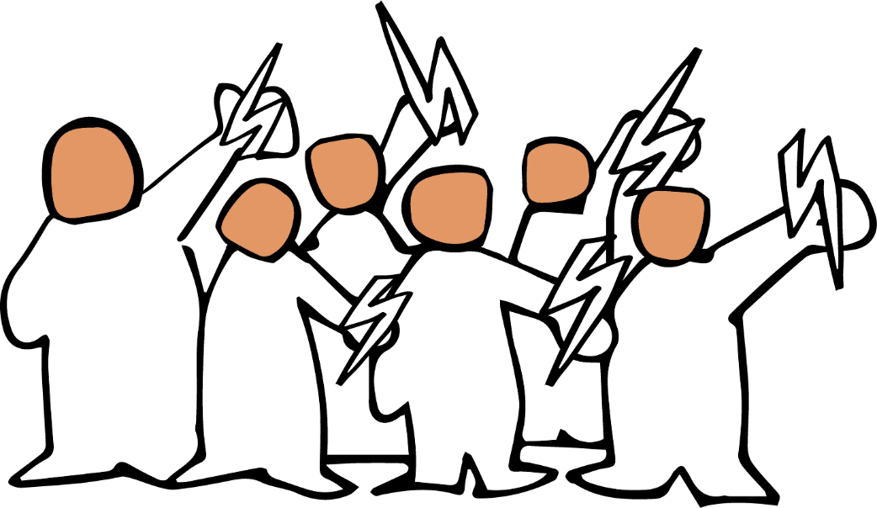
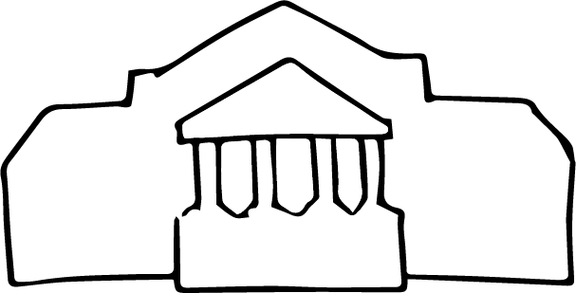
Notes:
Slides 3-13 illustrate the session 5 presentation.
Presentation: How things get worse (and better)
Introduction In the last session:
We focused on what violations of freedom of religion or belief look like and how they affect people’s lives.
We thought about who is committing the violations – the state, through the law and the actions or inaction of officials, or people in the community,
and we used drama as a tool to begin to explore what these violations can look like and to practice identifying them.

Slide 4
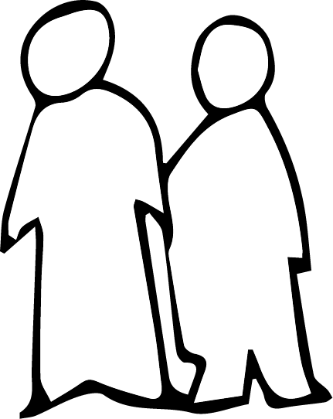
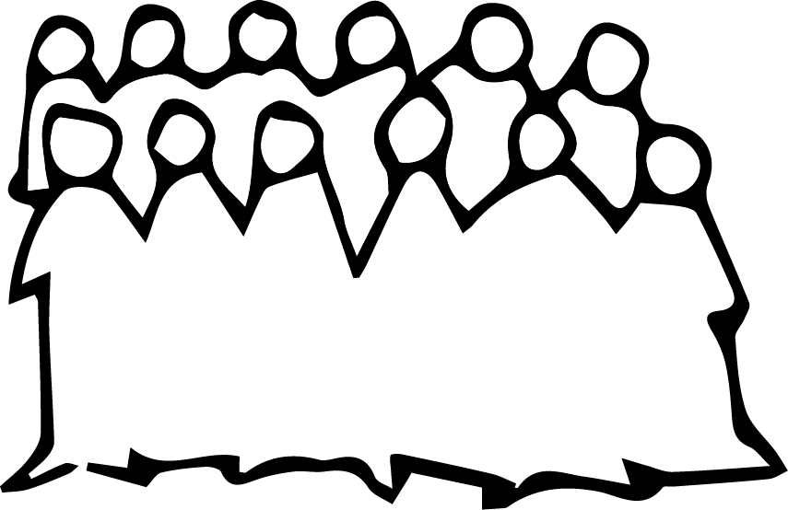
Notes:
We’re now going to think about how violations go from being moderate, to bad to worse – from occasional incidents affecting individuals, to systematic, widespread and severe attacks on peoples’ rights.
One way of thinking about how things get worse is to think about three phases – Disinformation, Discrimination and Violence.

Slide 5
Disinformation
Notes:
Three phases of persecution
The first phase is disinformation. In this phase, prejudices, stereotypes and lies are spread about individuals or about groups of people – like religious minorities for example. These prejudices are spread in lots of ways – in what parents, teachers and schoolbooks teach children, through the radio or social media or via the speeches of politicians and preaching of religious leaders.

Slide 6
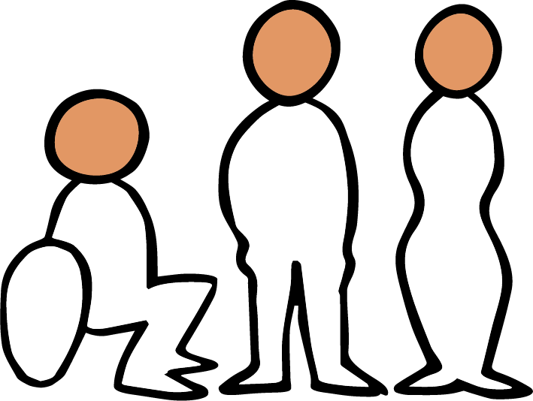
Notes:
No society is free from prejudice, but when prejudices and stereotypes go unchallenged, and especially when they are promoted by political and religious leaders, they grow to create a culture of intolerance and give rise to tensions between groups.
When that happens, it becomes easy or even normal for ordinary people, local officials and even the government to start not only thinking and speaking, but also acting in ways that discriminate against others. Disinformation makes discrimination seem acceptable. In its most extreme form, disinformation is used to incite people to believe that not only discrimination but violence towards others is acceptable or even right.

Slide 7
Discrimination
Notes:
Discrimination affects people in every area of life. In the last session, we looked at examples of state discrimination – for example discriminatory family and personal identity law, discrimination in the way the law is implemented by the police and the courts and discrimination in the provision of services, like education. We also saw examples of discrimination in the private sector affecting people’s access to employment.
No society is free from discrimination, but widespread and systematic discrimination can only persist when it is built upon a culture of ignorance and intolerance. Discrimination wouldn’t keep happening if the majority of people didn’t accept it.

Slide 8
Violence
Notes:
And just as disinformation creates a foundation for discrimination, together disinformation and discrimination form a foundation for violence. Violence in the community can take lots of forms – from vandalism to harassment, to threats to physical violence. And state violence can involve arbitrary imprisonment, torture, and gender-based violence.

Slide 9
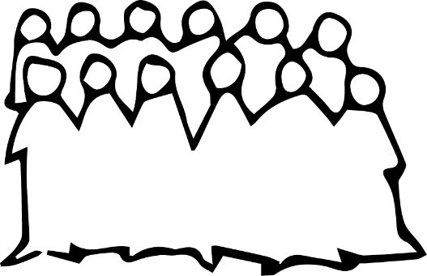
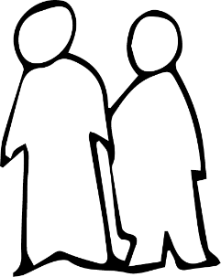
Scale
Frequency
Impact
Notes:
Scale, frequency and impact
All three types of problem – disinformation, discrimination and violence can take place with different levels of scale and frequency, and with different levels of impact. A violation can affect a few individuals or huge groups.
It can be occasional, regular or systematic – which means it is built into the systems and structures of society. And it can have a limited or a devastating impact on the people affected.

Slide 10
Notes:
Experience in many countries tells us that the more widespread and severe prejudices and misinformation are, the more widespread and severe discrimination becomes. And the more widespread both of these are, the greater the likelihood of widespread and severe violence. One thing leads to another.
This may sound depressing but understanding how things get worse can help us to think about how things could get better.

Slide 11
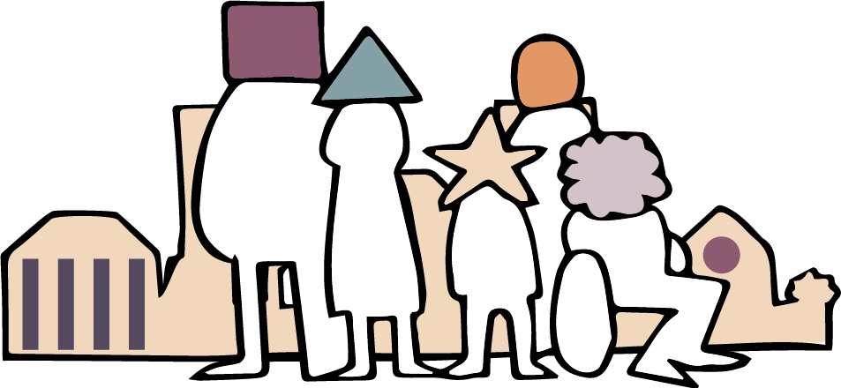
Notes:
Conclusion Everything starts with the way we think, speak about and treat one another. And that is something each one of us can do something about – in our families and personal networks. It is also possible that we could do something about it at the community level – for example in relation to our faith communities, schools and workplaces.
Of course, this isn’t enough. We also need to change the official systems that discriminate and harm people – from bad laws to the behaviour of officials like schoolteachers or police officers.

Slide 12
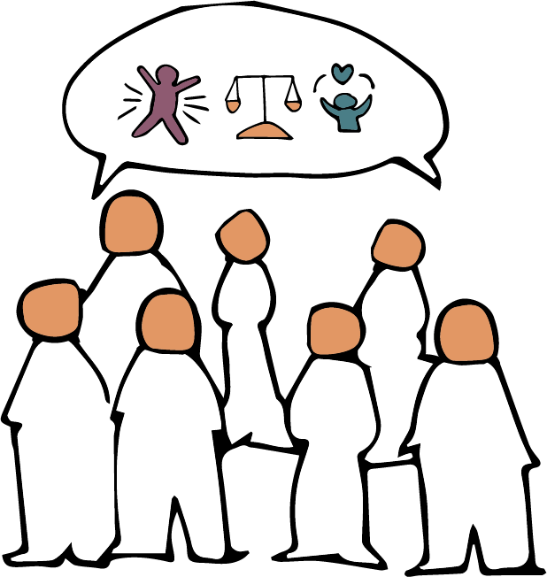
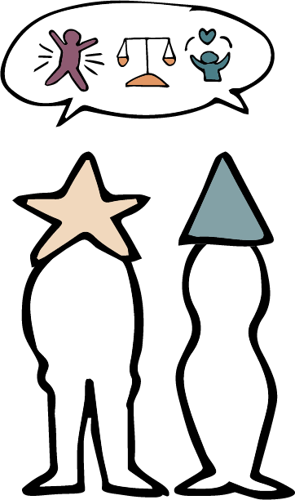
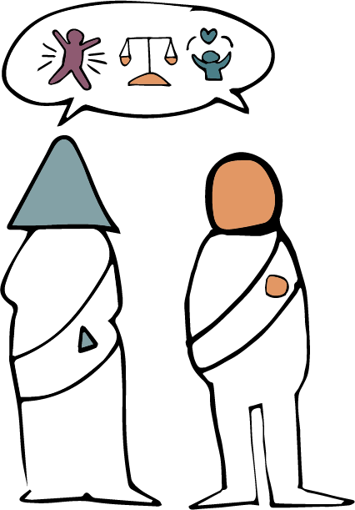
Notes:
To make that kind of change possible we need minorities who know their rights and are equipped to stand up for them, majorities who are prepared to stand with them, and political and religious leaders who understand their responsibilities to respect, protect and promote human rights.

Slide 13
Disinformation – Discrimination – Violence
Notes:
Making this a reality is a slow and difficult process. That process begins when we analyse our context and identify what the problems are.
We can use this three-phase model of disinformation – discrimination – violence to help us do that.

Slide 14
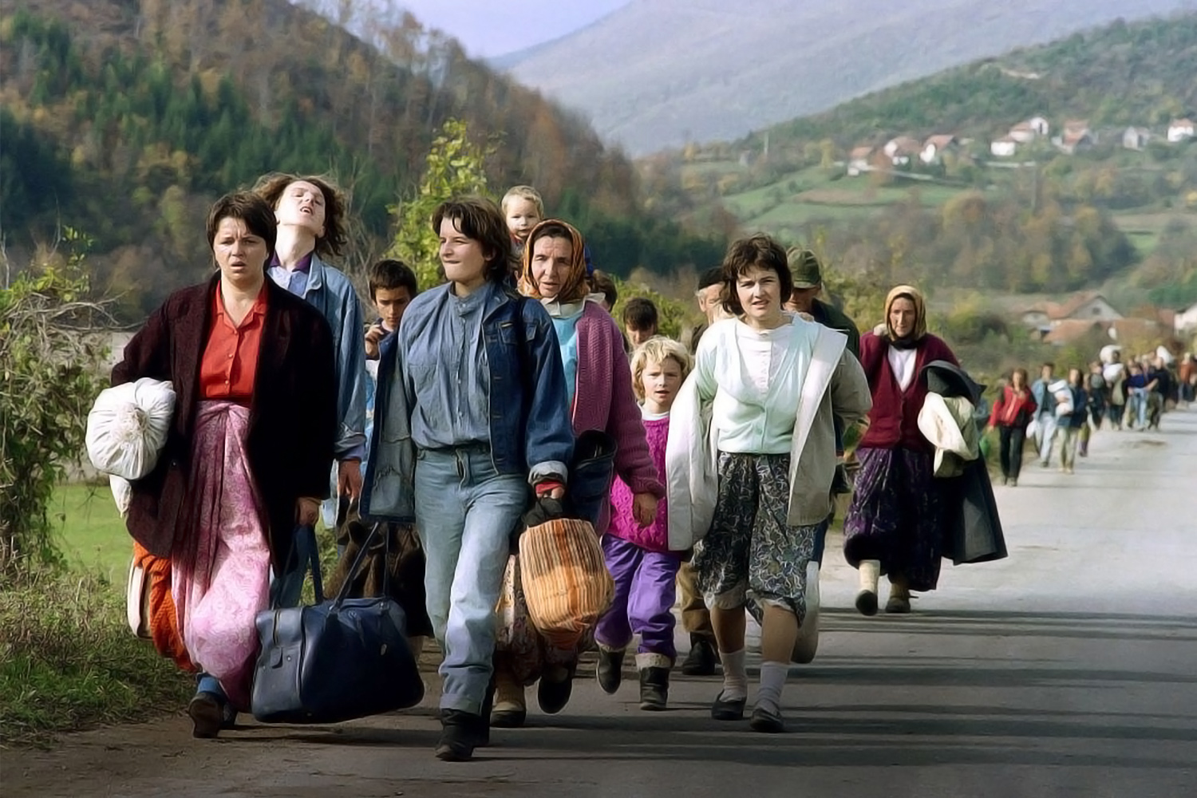
Photo: Patrick Baz / Getty Images
Notes:
Slides 14-19 illustrate Emina’s story, used in the concluding comments of the session.
Emina’s story, Bosnia Herzegovina
At the end of Bosnian war in 1995, the religious landscape of Bosnia Herzegovinia changed dramatically. Some areas that had a Muslim majority became Christian majority and vice versa.
Ethnic and religious tensions remain, and people who return to their original home areas are especially vulnerable.

Slide 15
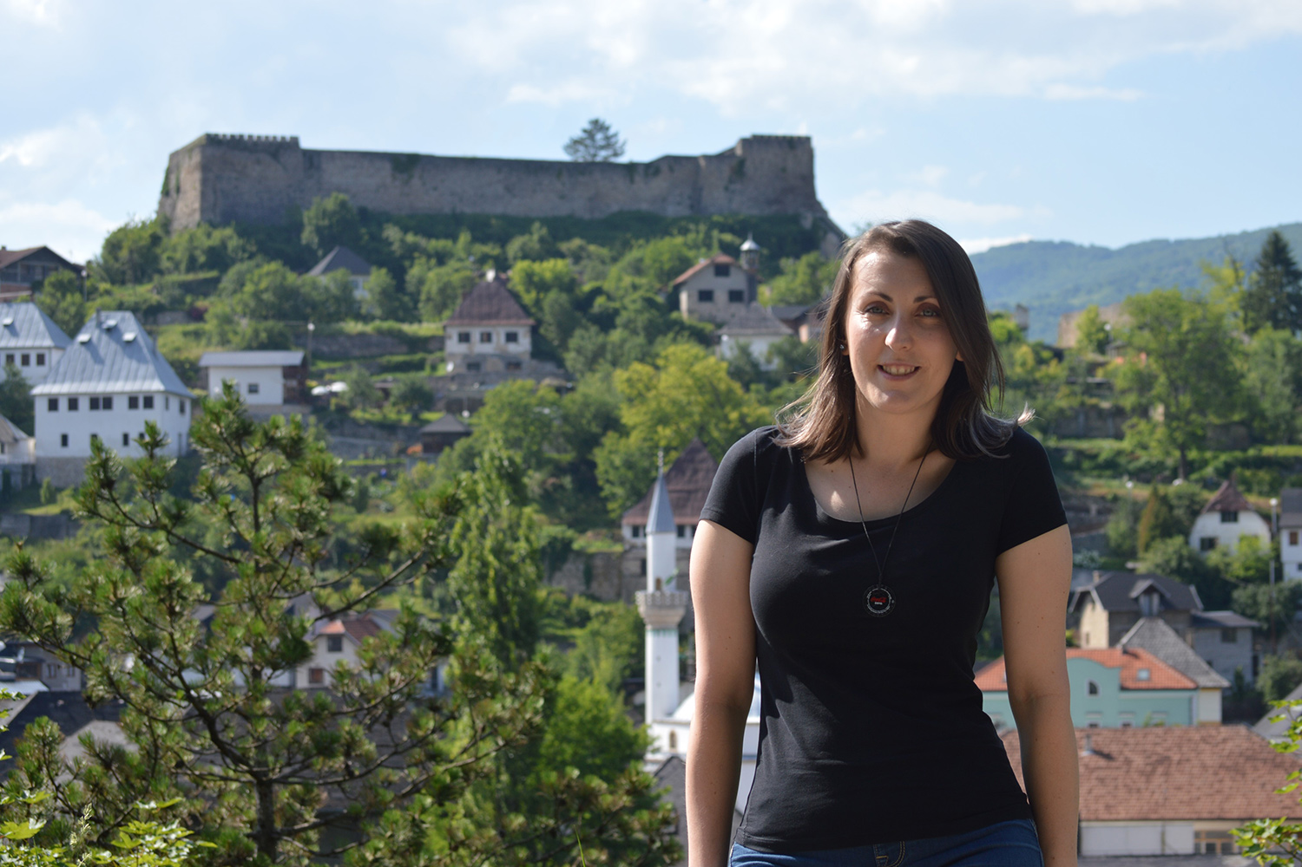
Photo: Emina Frljak
Notes:
This is Emina. Emina wanted to contribute to positive change, so she took a short human rights training course run by a Bosnian NGO called Nahla. “I gained so much from the course. I understood what Freedom of Religion or Belief means and started recognising violations in my own context. I began reporting hate speech on social media.”

Slide 16
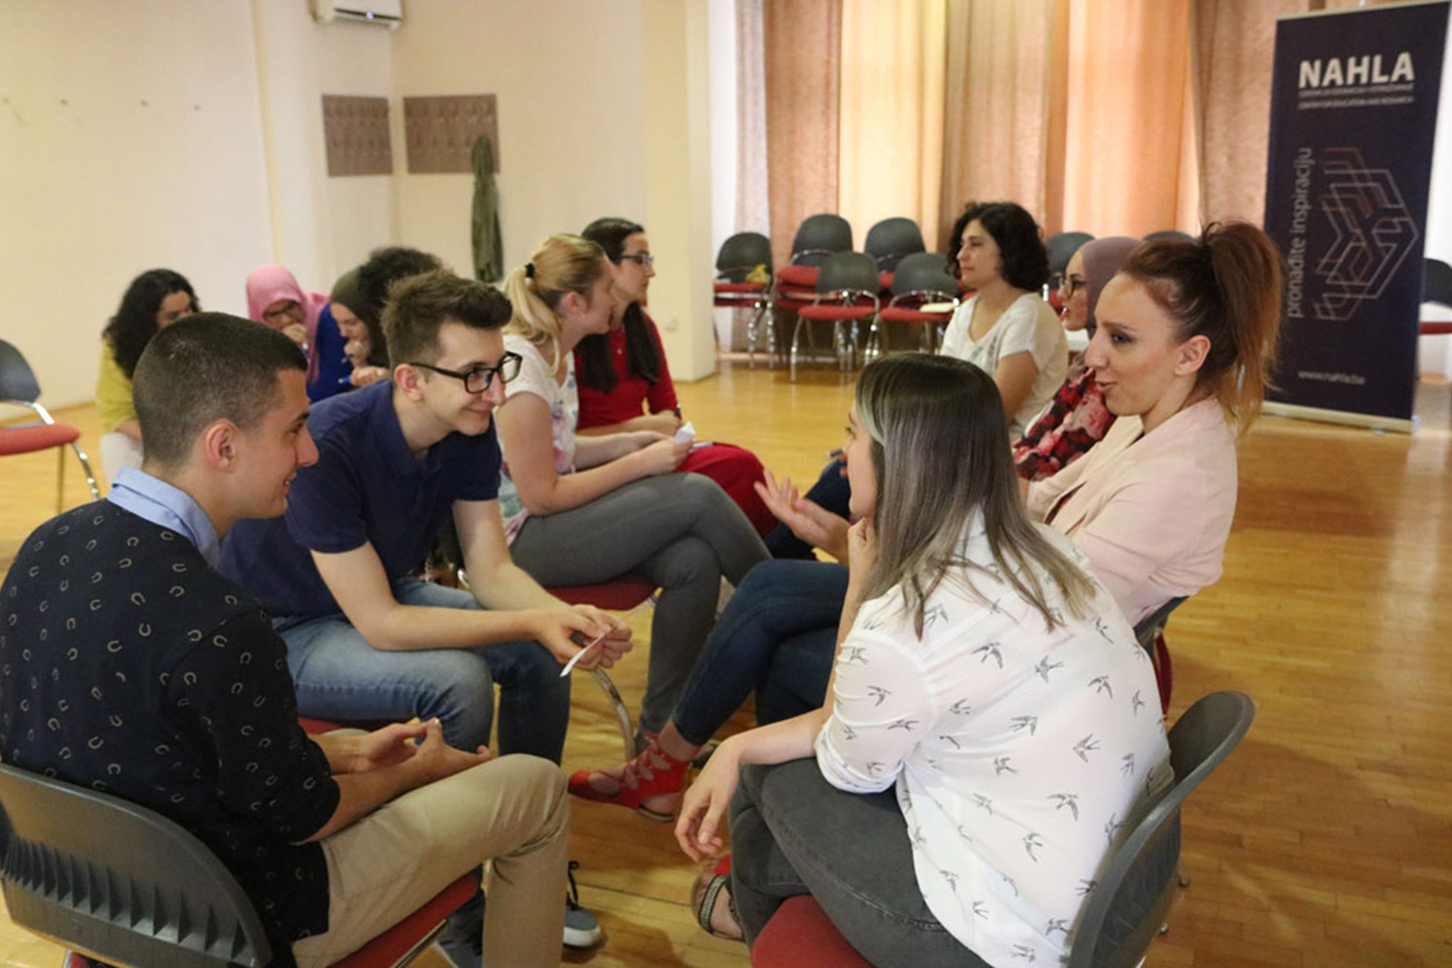
Photo: Nahla Center for Education and Research
Notes:
After the course, Nahla introduced Emina to a group of young volunteers who use reports from respected and reliable local and national media to document violations of freedom of religion or belief in the country, compiling a list of all the incidents that take place each year.

Slide 17
Threat (Bias against Muslim)
Muslim returnees were threatened and subjected to anti-Muslim insults when a convoy of cars playing nationalist hate songs drove through their village on a day associated with Serb nationalism.
Attack on property (Bias against Christian) Religious artifacts were burned at the Nativity of Holy Mary Serbian Orthodox Church in Čekrekčije, Visoko city.
Notes:
Emina says, “We have a set of questions we use to categorise the incidents, for example which community is affected and the type of violations – threats, attacks on property or attacks on people and so on.”

Slide 18
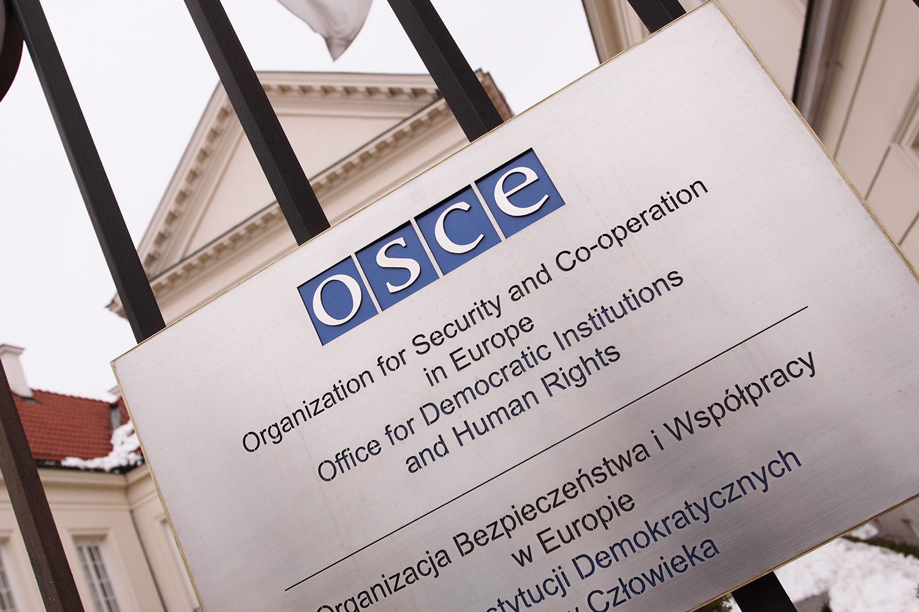
Photo: Steven May / Alamy Stock Photo
Notes:
The group sends their reports to the authorities and the media in Bosnia and to international bodies such as the Organisation for Security and Cooperation in Europe (OSCE), which often includes information from the volunteers in its annual report.

Slide 19
Photo: Emina Frljak
Notes:
Emina says, “I think all our actions make a difference, no matter how small they seem. Documenting and bringing international attention to violations could help persuade the authorities to take the issues seriously. Raising awareness about human rights abuses helps us understand our own biases too.”

Slide 20
Well done and welcome back!
Next session: Inspired by stories – Empowered by tactics

