Slide 1
The Local Changemakers Course

Slide 2
SESSION 2
Introducing freedom of thought, conscience, religion and belief

Slide 3
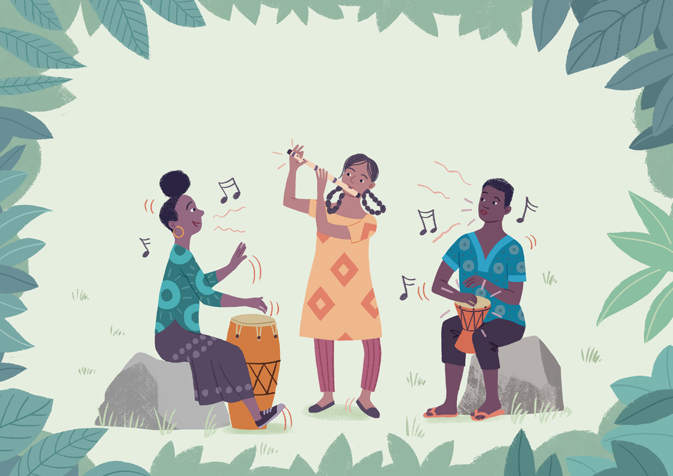
The Songs of
the Flute and the Drum
Illustrated by Toby Newsome
Notes:
Sides 3-23 illustrate the story used in the Once upon a time exercise.
The Songs of the Flute and the Drum
By Katherine Cash and Sidsel-Marie Winther Prag.
Illustrated by Toby Newsome.

Slide 4
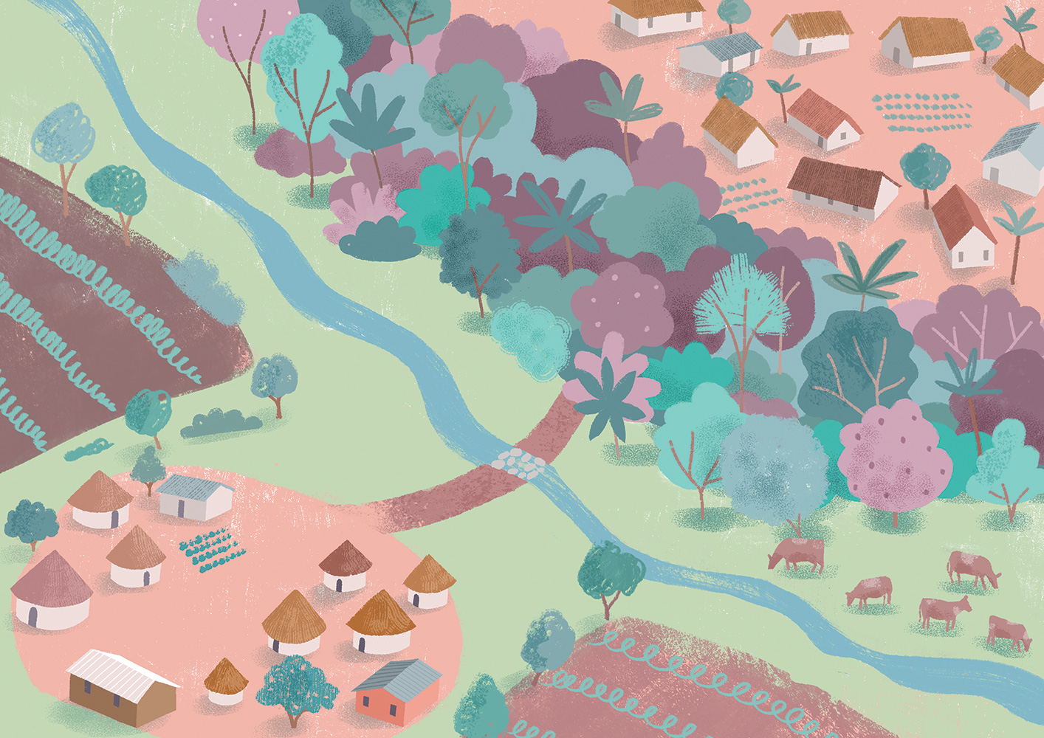
Notes:
Once upon a time, there were two villages.

Slide 5
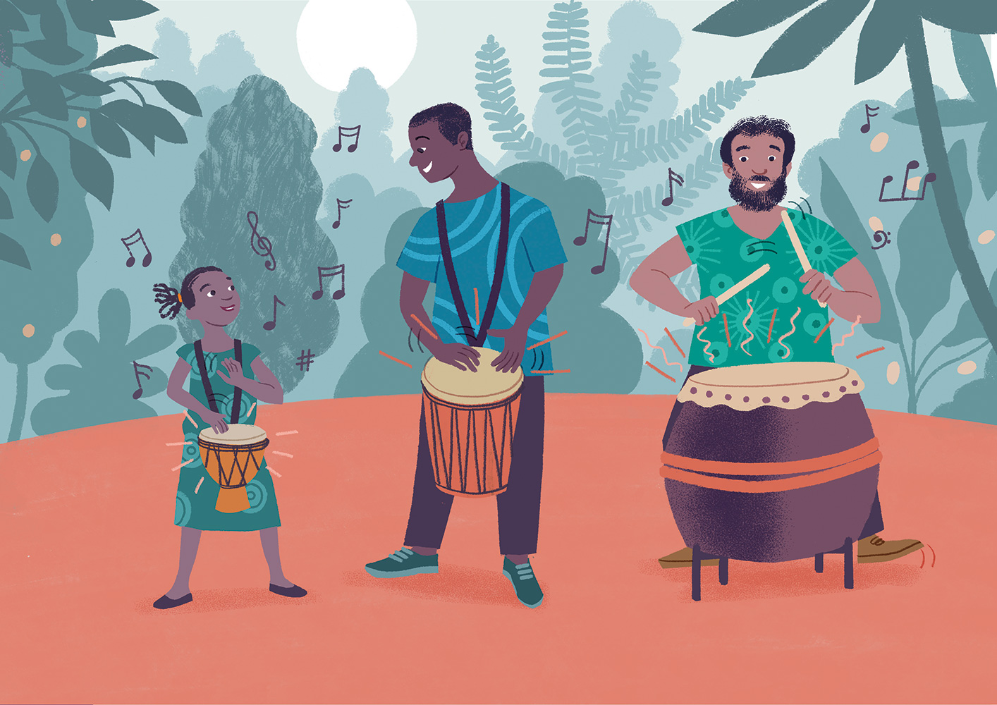
Notes:
The people of the village in the forest were renowned for drumming and dancing. The moment a child could sit upright, they were given a drum. There were tiny drums that sounded like quiet rainfall and great thunderous drums that took two to carry. Drumming accompanied life - celebrations, mourning and everything in between - and the people believed that the drumming kept their lives in harmony with the spirits of the forest.

Slide 6
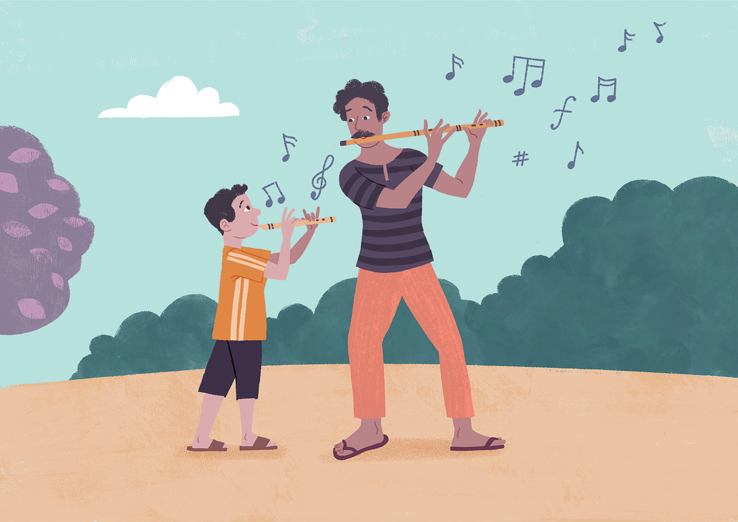
Notes:
The people of the village in the valley below had never understood the drummers. They found the drumming intrusive and sniggered at the simple ‘banging’. When a boy was born in this village, his father carved a flute from wood or bone and the boy carried it on a string around his neck until his life’s end. It took many years to master their traditional melodies and the highest honour was bestowed upon men whose skill made the flute sing so sweetly that the God of the heavens would be enchanted and grant rain and sunshine for the fields.

Slide 7
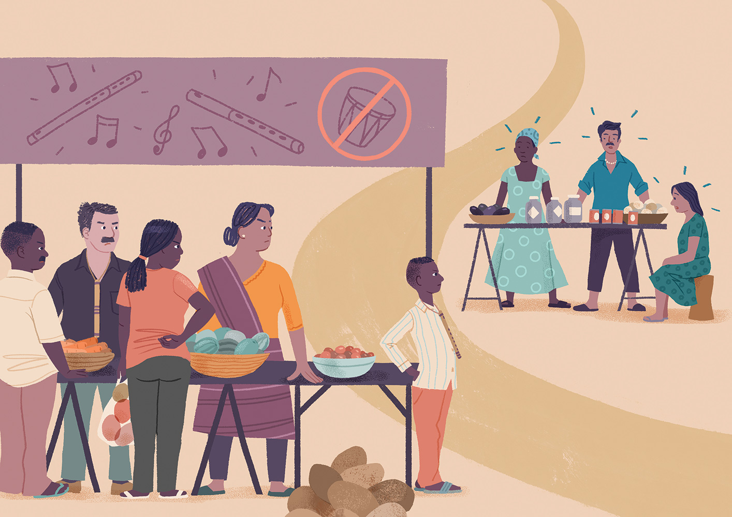
Notes:
Although villagers from Drum village went to the weekly market in Flute village to sell their wares, people from the two villages did not mingle. Drumming was banned in the marketplace. Many stall owners from Flute village refused to sell to the drummers and the drummers resented the flute villagers.

Slide 8
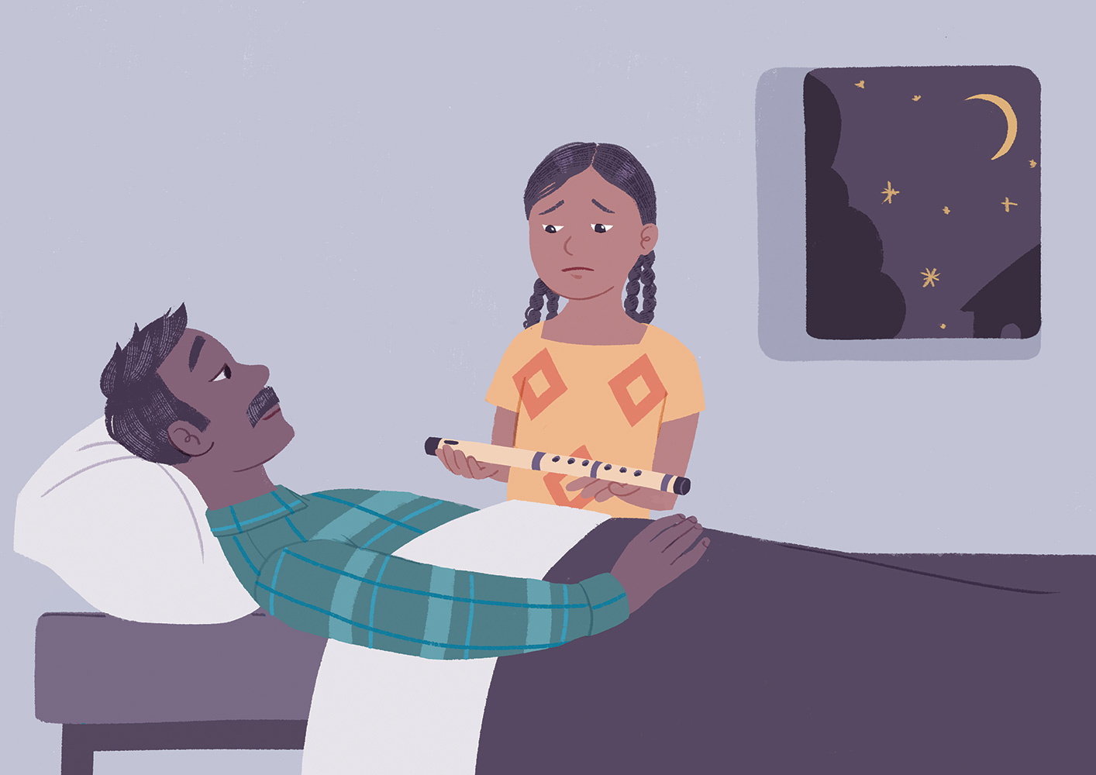
Notes:
A young girl, an only child named Ziana, lived in Flute village. Her curiosity and kindness made her loved by all. When she was 10 years old, her father fell ill. One day, he called her to him, "My dearest daughter, I will not live for long. Take my flute and wear it so we will always be together". Ziana was mortified; it was not customary for girls to carry a flute, but soon she asked herself, "Why shouldn’t I be allowed to play?" On the night her father died, Ziana took the flute and hung it round her neck.

Slide 9
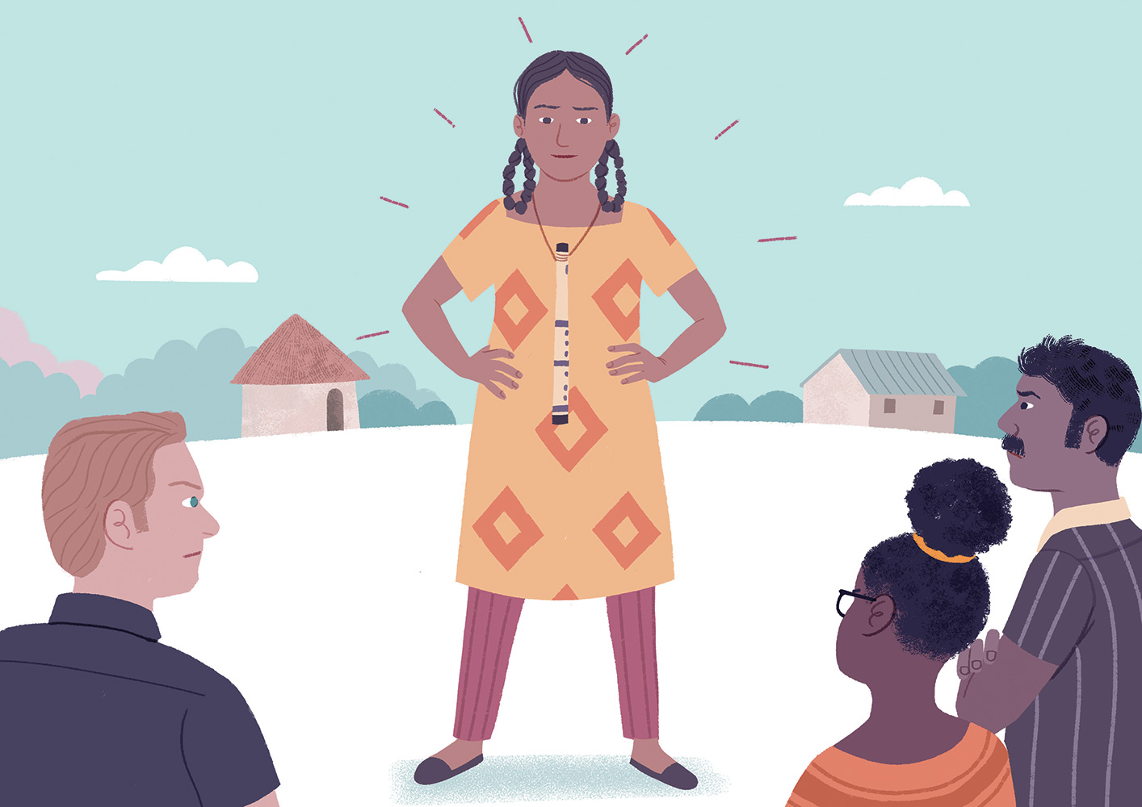
Notes:
As Ziana grew she worked hard helping her mother grow vegetables to sell at their market stall. Although she was diligent and kind, people in Ziana’s village often sneered at her because she wore the flute. Sometimes they would try to convince her to take it off, but she refused. Whenever she had the chance, Ziana would escape to the forest and play her father's flute.

Slide 10
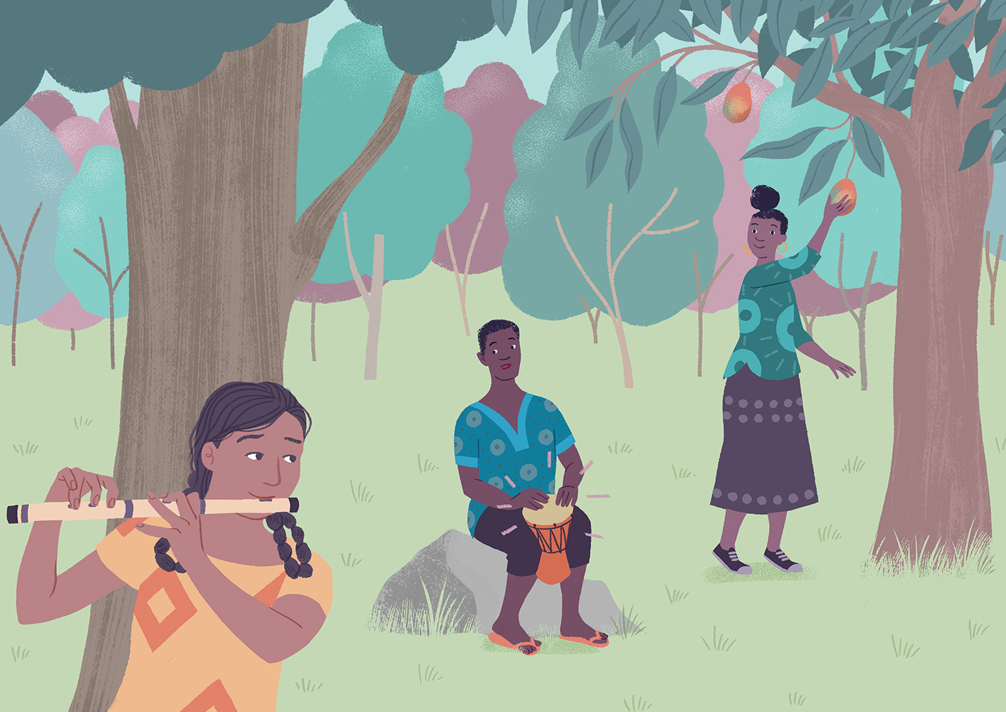
Notes:
On one such day, Ziana heard a faint drumming. Curious, she followed the drumbeats through the forest to a clearing, where a young man was drumming and singing, while his sister picked fruit from a tree. Ziana recognised them from the market - they were siblings called Ono and Iris.
Hiding behind the trees, Ziana began to play along on her flute. The song of the flute and the rhythm of the drums danced alongside each other in beautiful music.
When the song finished, Ziana stepped cautiously into the clearing. Ono and Iris were surprised to see a girl with a flute but smiled, realising that she, like them, was not allowed to play her instrument in Flute village. Iris offered Ziana some fruit, and the three chatted and played music until evening fell.

Slide 11
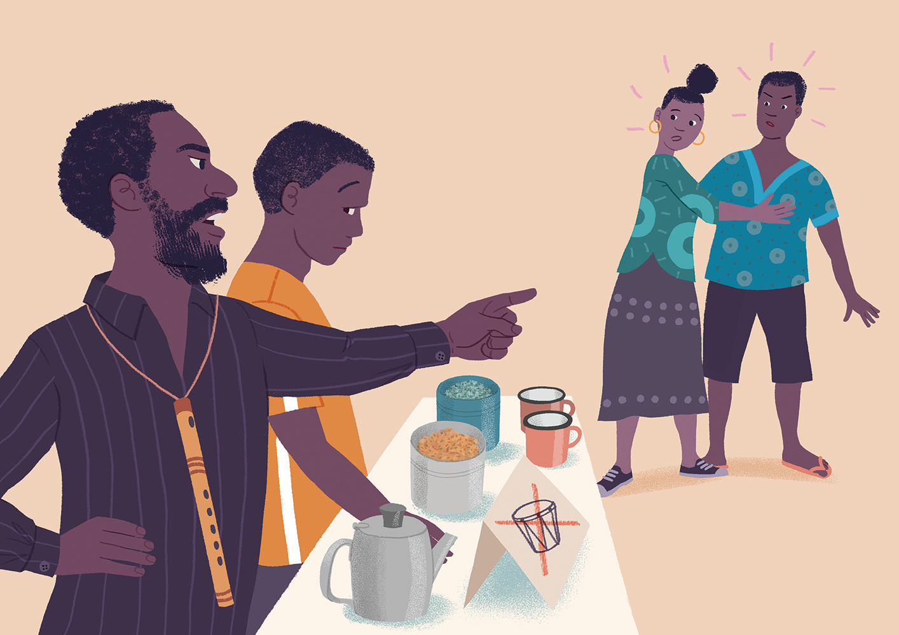
Notes:
Next market day Ziana saw her new friends in front of the tea stall. The stall owner was yelling at them, "Get away, drummer filth!" Ono was angry, but Iris dragged him away. The stall owner’s son, who had been pouring tea for Ono, looked ashamed.

Slide 12
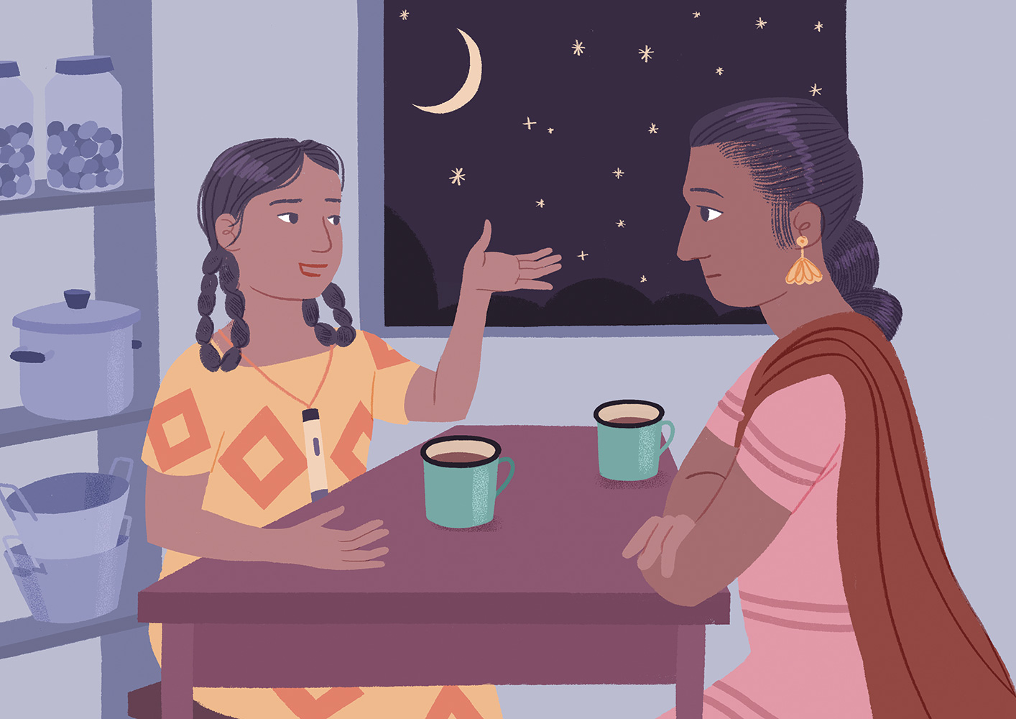
Notes:
Ziana had never thought about the ‘No Drummers’ signs before. Her heart felt heavy as she realised that she and her mother had never bought anything from the drummers' stalls.
That night Ziana talked to her mum and asked why they never went to the drummers’ stalls. "It's better to stick to what you know," her mother replied, but Ziana couldn’t understand and kept asking why everyone shouldn’t be welcome everywhere and raving about the delicious fruits Ono and Iris sold at their stall. Finally, Ziana’s mother agreed to try some of their fruit on the next market day.

Slide 13
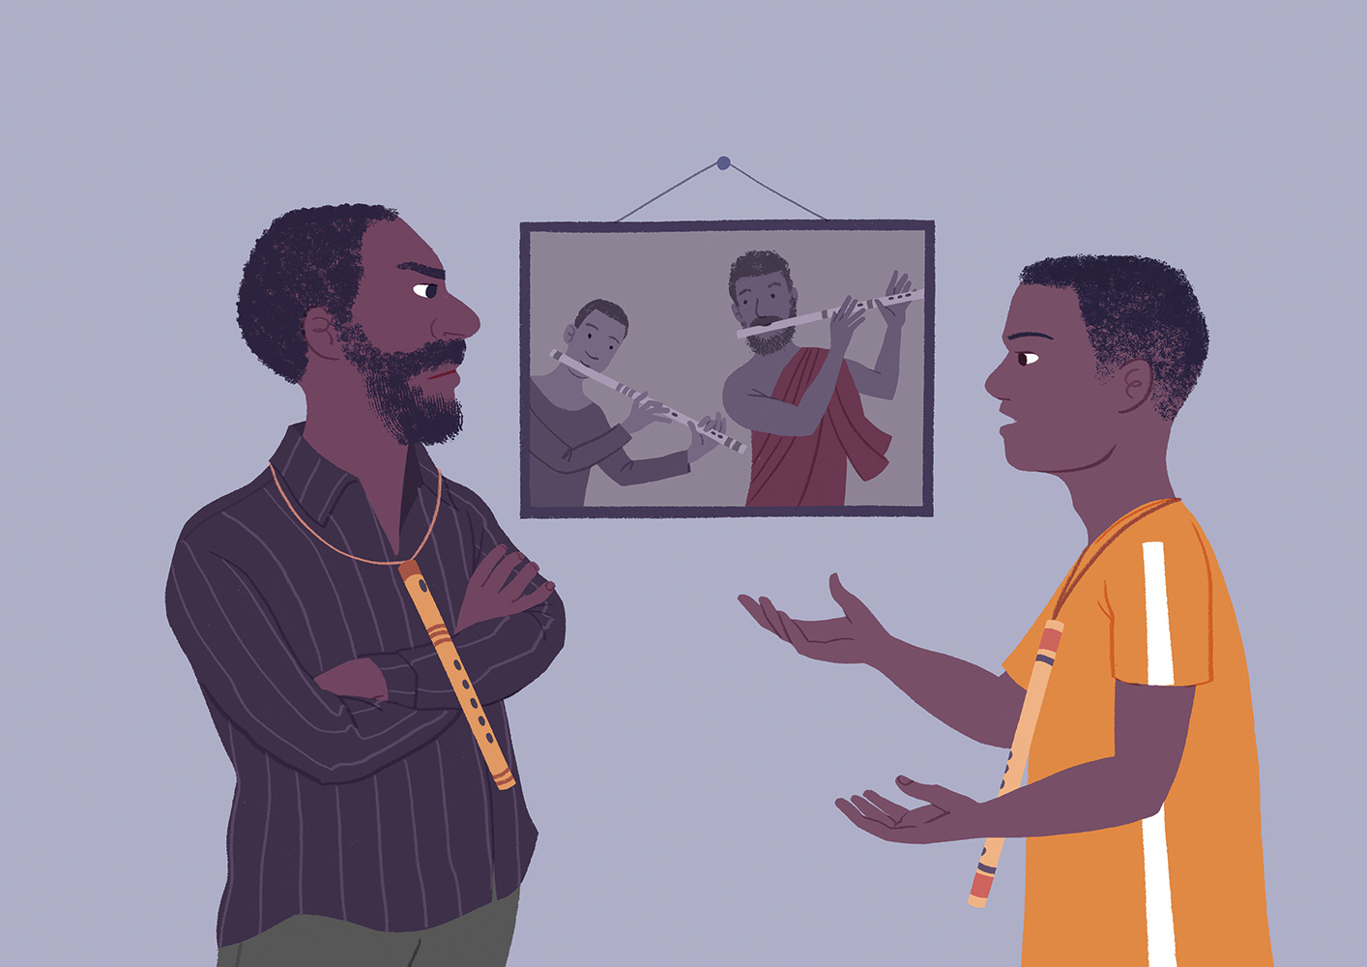
Notes:
Meanwhile in the tea stall owner’s house a row had broken out when the owner’s son, Brone, questioned his father’s treatment of the drummers. The stall owner was one of the most honoured flute players in the village and a proud man. His father and grandfather had been skilled musicians, but his son was a deep disappointment. No matter how hard Brone tried, he could not master even the most basic melody. After years of forced practice and cruel comments, Brone had lost all appreciation for the flute. He felt drawn to the distant rhythm of the drums and dreamed of another life.

Slide 14
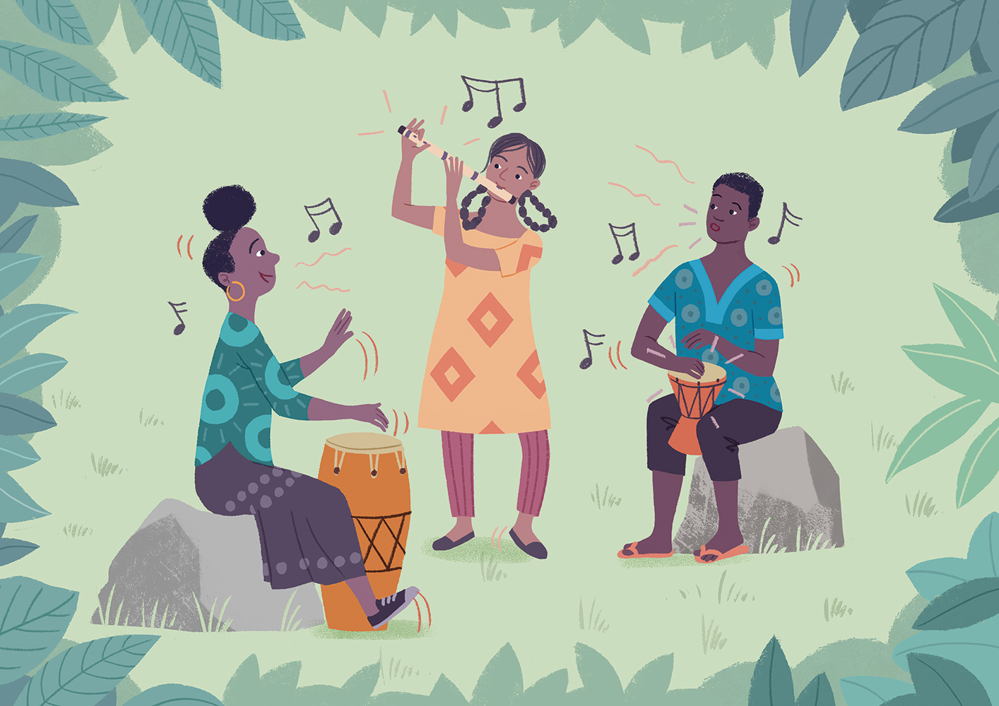
Notes:
As time went by Ziana, Iris and Ono kept meeting in the forest to play together. They too dreamed - of a time when everyone would be welcome, where drums and flutes could be played openly and where they could play their beautiful music together in the marketplace.

Slide 15
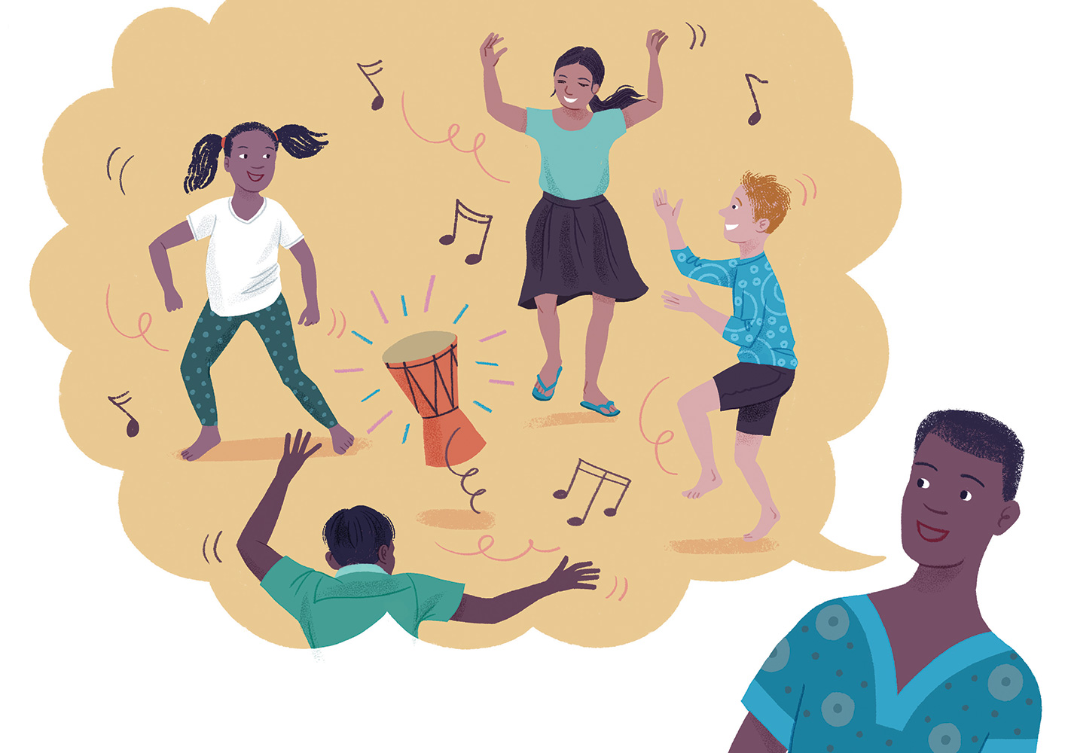
Notes:
Each week, Ono and Iris would visit Ziana and her mother at the vegetable stall and Ziana’s mum would buy fruits and nuts from them. One day, Ono noticed Ziana's mother looking curiously at the drum he carried on his belt. "This is the laughing drum", Ono said, "Its sound means happiness and the children dance and laugh when I play it". Ziana's mother was fascinated.
Other drummers began to gather around, and Ziana and her mother asked about their drums too. That day, Ziana's mother sold her vegetables very quickly. Some neighbouring stall owners were upset with her for welcoming drummers to their part of the market, but Ziana's mother reasoned that if everyone could buy from each other, they would all be better off.

Slide 16
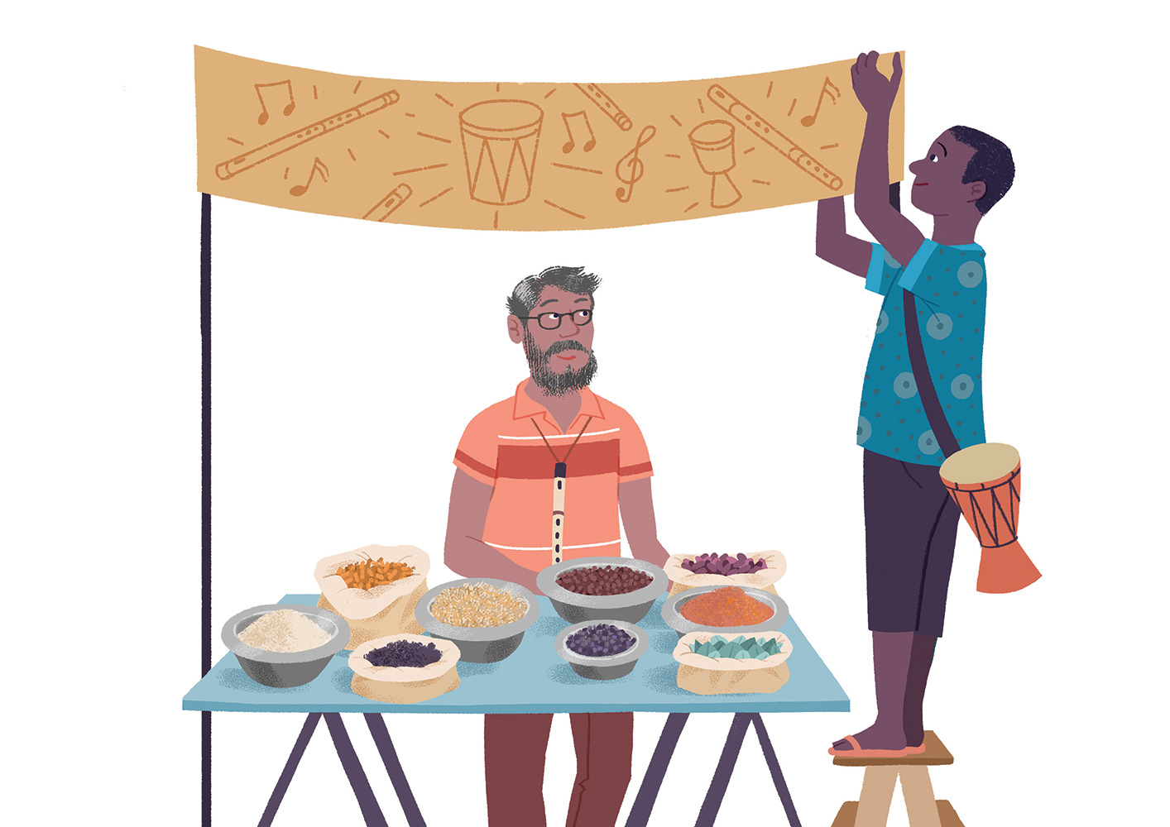
Notes:
Next to their stall, an old man was selling spices, but business was bad. Ono suggested putting up a sign saying, "Everyone welcome" to boost trade and painted the sign for the old man, with the image of a drum and a flute.
The old man’s sales increased, and slowly other stall owners were convinced. The "Everyone welcome" sign began to appear on stalls owned by drummers and flute players alike. The market thrived.

Slide 17
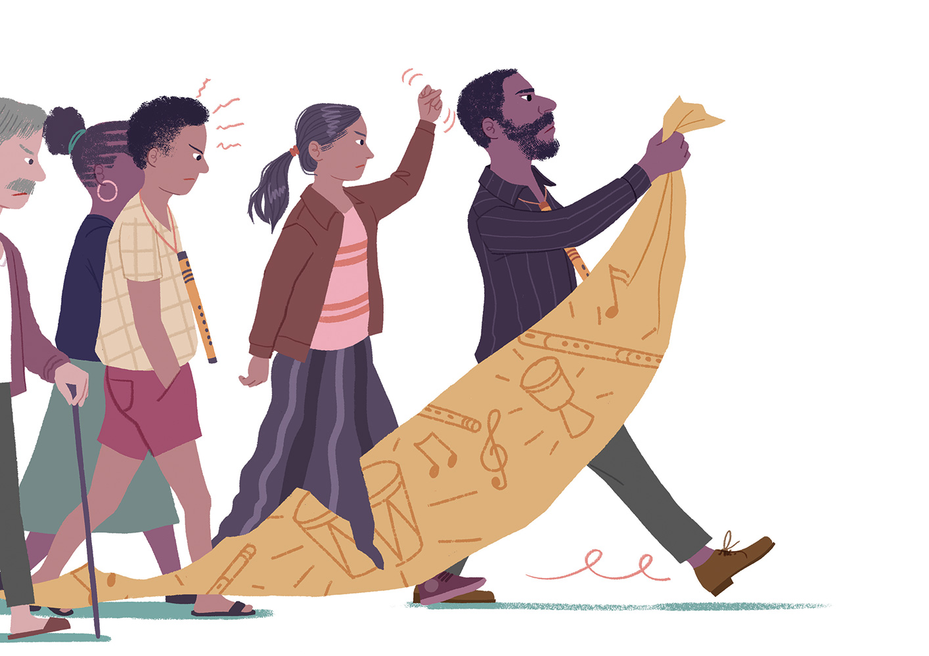
Notes:
But all was not well. Brone’s father was horrified by drummers entering his part of the marketplace. He saw them as a threat to the old ways and gathered people who felt the same way to tear down the signs and harass the drummers. Tension grew in the marketplace and the market council grew worried.

Slide 18
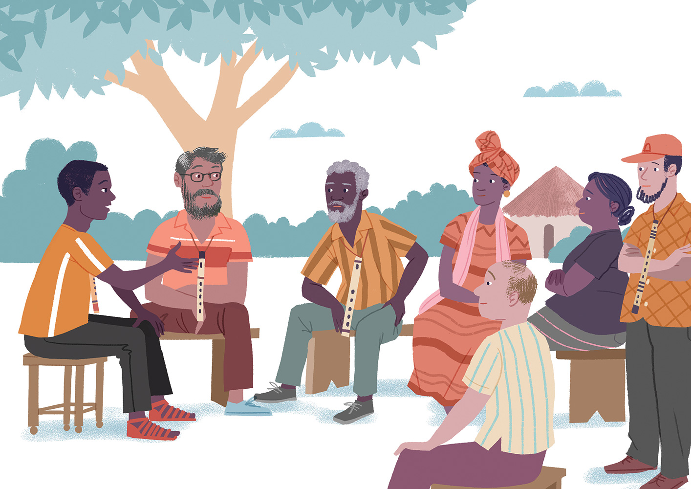
Notes:
Brone refused to participate in his father’s scheme. Instead, he and the old spice seller spoke to the market council and persuaded them to host a concert for everyone in the marketplace. Perhaps Brone’s father and the others might learn to accept the drummers if they could listen to their stories and hear their songs.

Slide 19
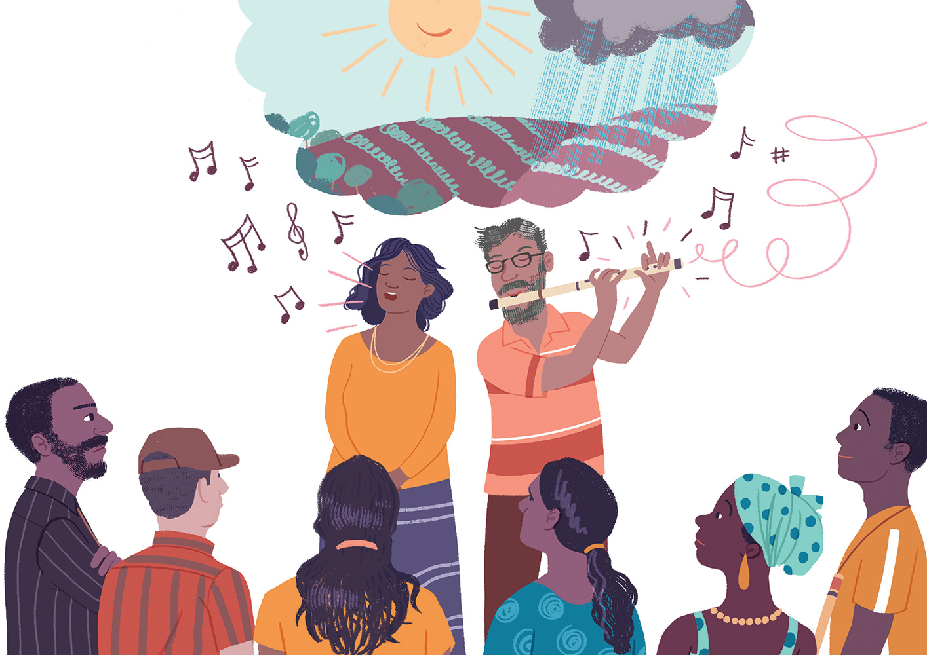
Notes:
Word about the concert spread and people came from afar. The stall owners sold much more than usual that day.
Finally, it was time for the concert. The old spice seller played a beautiful tune on his wooden flute, while his daughter sang a song of gratitude to the God of the heavens for a good harvest. He explained why the song meant so much to him after years of hardship in his youth. Brone’s father raised an eyebrow as he observed the smiles and nods of some of the drummers in the crowd.

Slide 20
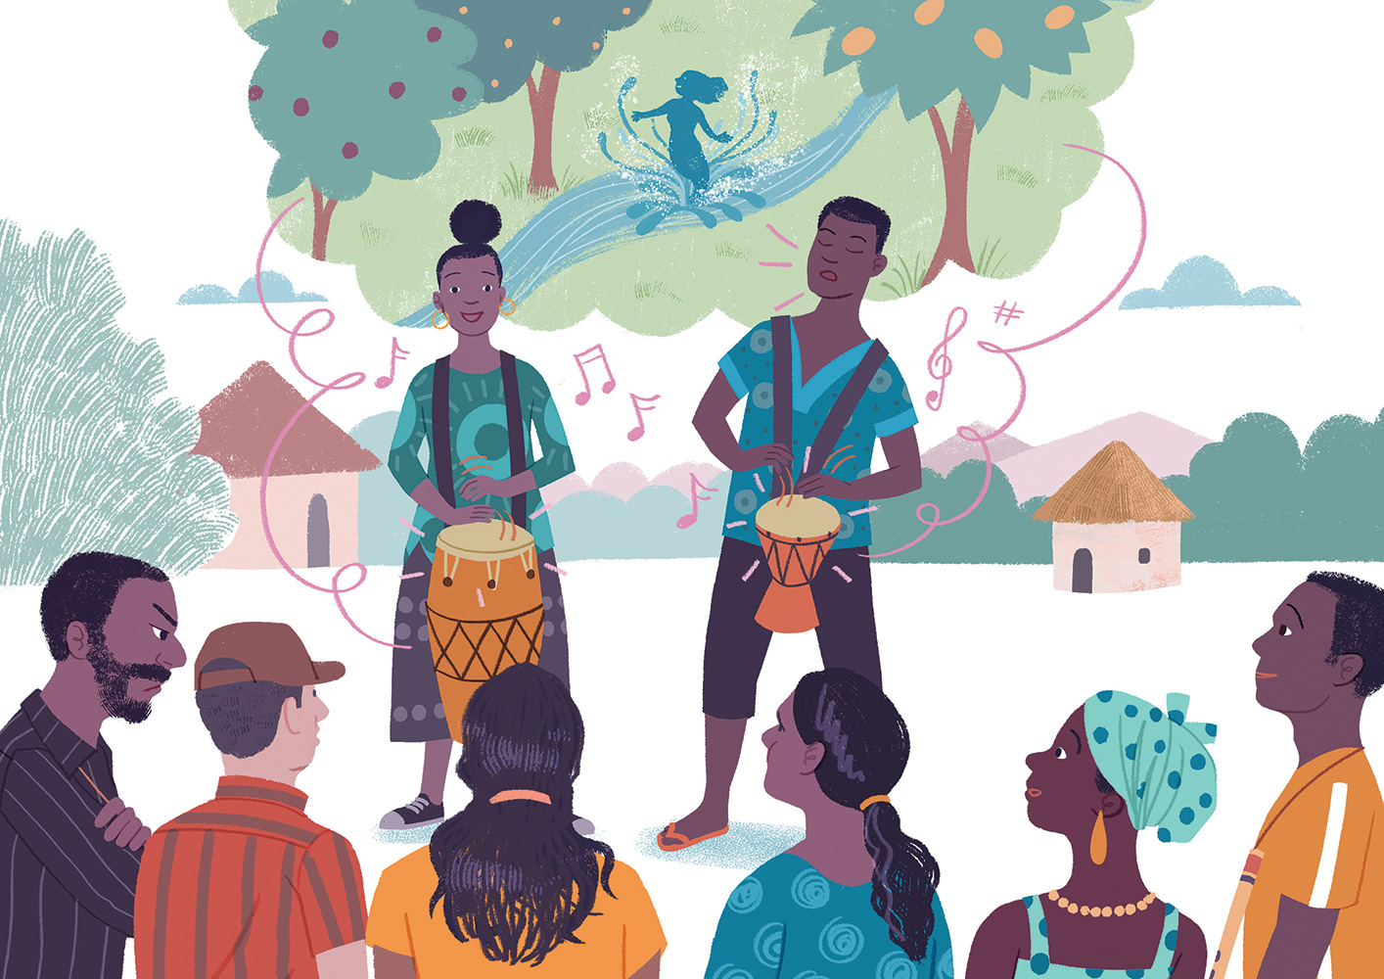
Notes:
The old man invited Ono and Iris to the stage. They told stories of their drums and performed playful melodies in honour of the dancing spirit of the forest stream, and thunderous songs to thank the storm spirit for keeping their fruit trees safe. For the first time, the flute villagers began to understand what the drums meant to the drummers. Brone’s father scowled.

Slide 21
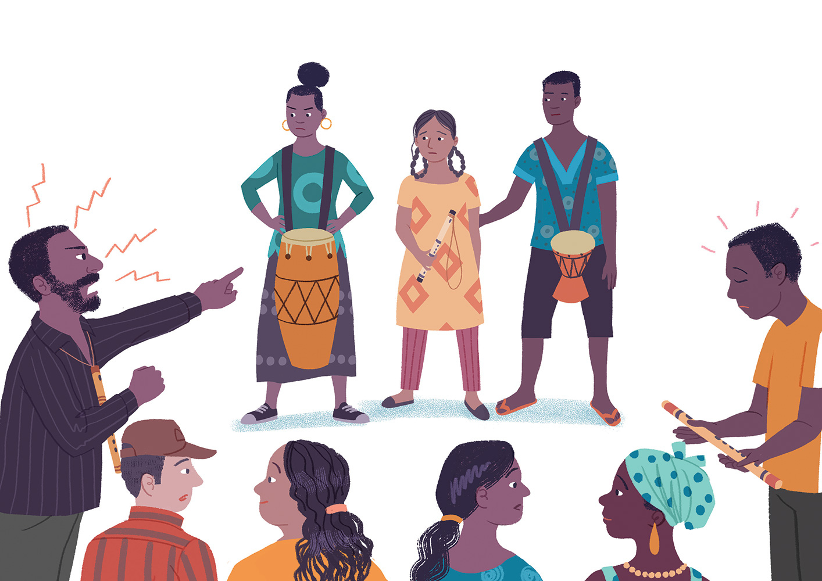
Notes:
Finally, Ziana joined Ono and Iris on the stage. She thought of her father, put his flute to her lips and the three began to play together. A shocked silence fell. Never before had the flute and drums been heard together or a girl been seen playing the flute.
The melody of gratitude for sun and rain from Ziana’s flute floated through the air in time to the rhythm of the dancing stream from Ono’s drum.
The song ended and the crowd looked from one to another. Some clapped hesitantly while others looked away. Brone’s father exploded at Ziana. "Traitor!" he shouted and stormed off.
Brone’s face was sorrowful as he looked at his father. Shaking his head, he took the flute from his neck, laid it on his father’s stall, and left the village for good.

Slide 22
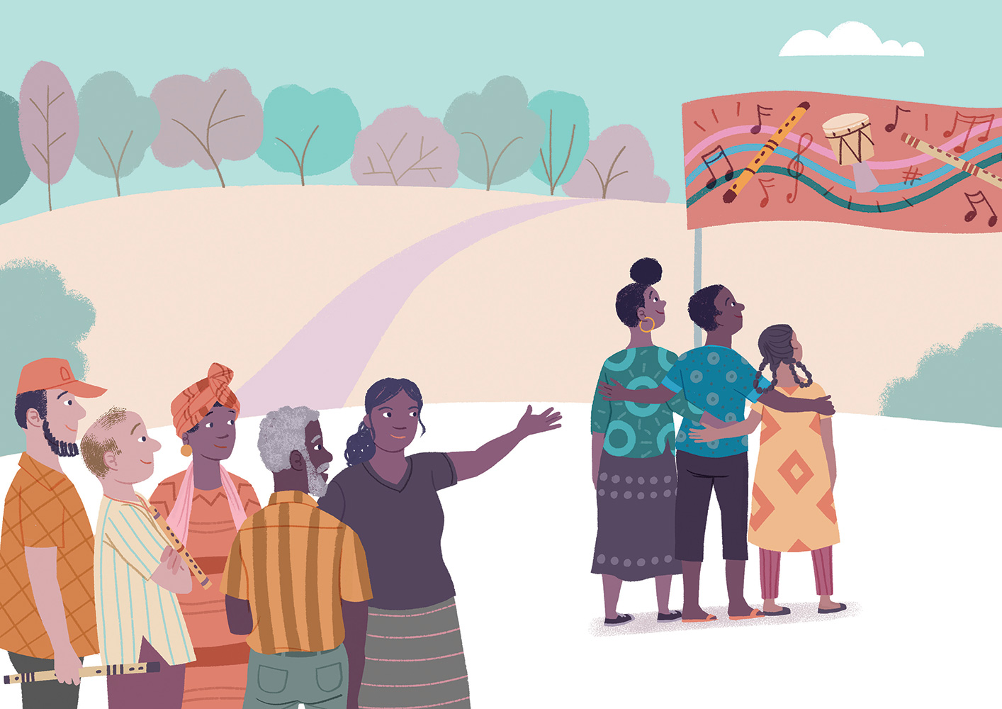
Notes:
There was much discussion in both villages after the concert. Should everyone be served at all market stalls? Should girls be allowed to play the flute and should the flute and the drum ever be played together? After many months, the villagers could still not agree.
Having listened to the drummers’ experiences and seen the sincerity of all the people, the market council ruled. “All people will be treated well in the marketplace!” The ban on drumming was lifted and the remaining ‘no drummers’ signs were taken down. But for other questions on the playing of instruments, the council refused to take sides. Instead, the sincere belief of each person would be respected and they would be free to follow it.

Slide 23
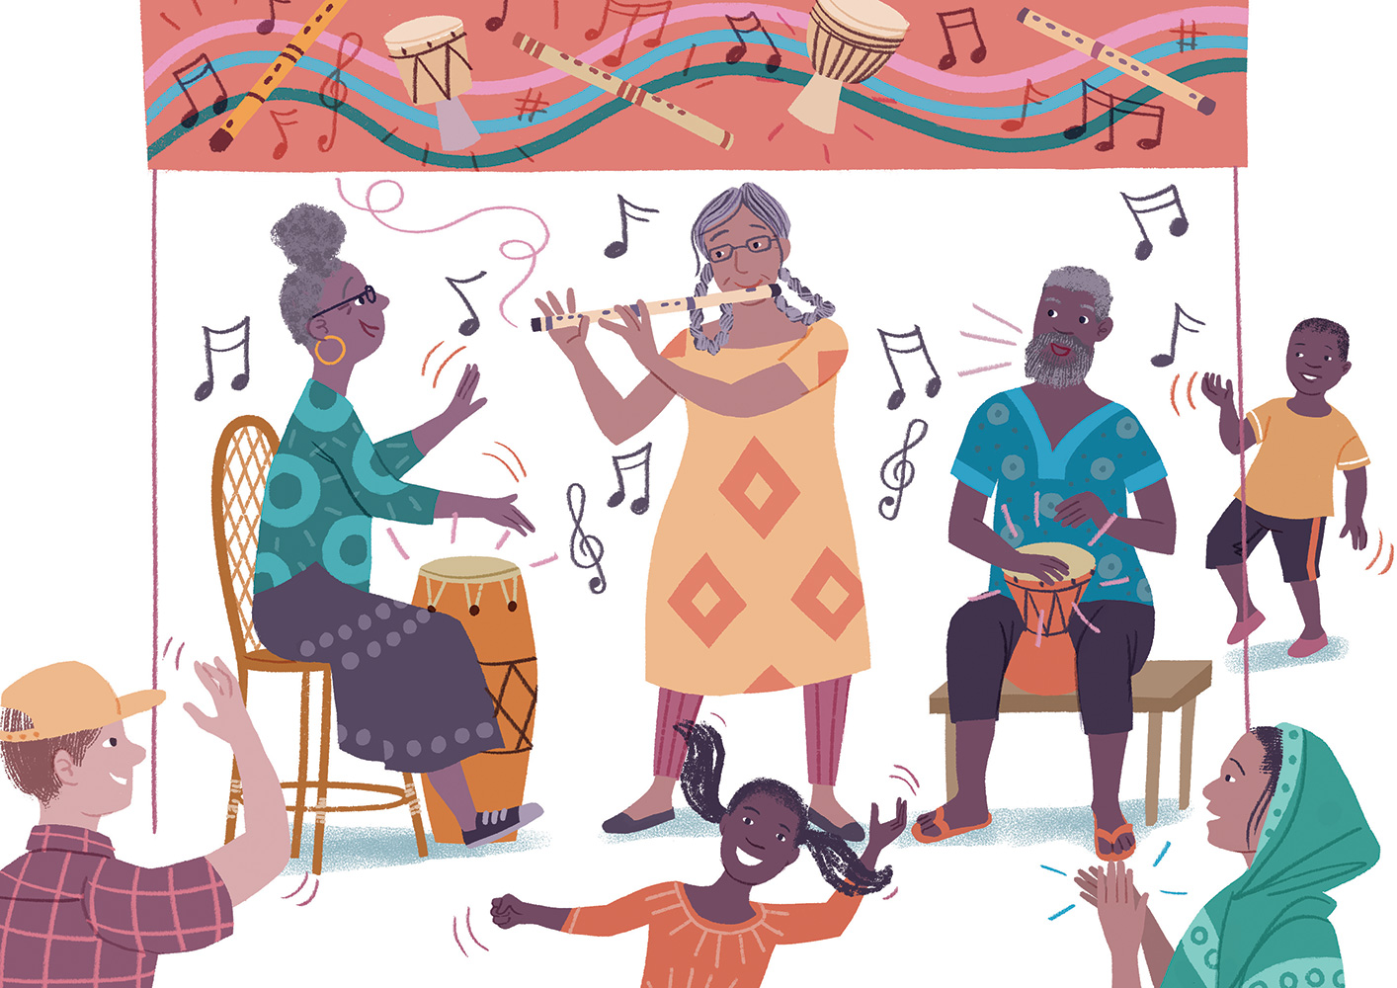
Notes:
It took many years before the drummers felt welcome at every stall in the market, but every week Ziana, Ono and Iris could be seen together playing the songs of the flute and the drum, until their fingers grew stiff and their hair turned white.

Slide 24
Think, Believe, Belong, Practice, Question, Change, Refuse.
Notes:
This slide should be shown as you introduce the Once upon a time small group discussion. Explain that each of the words on the slide relate to the story in some way.

Slide 25
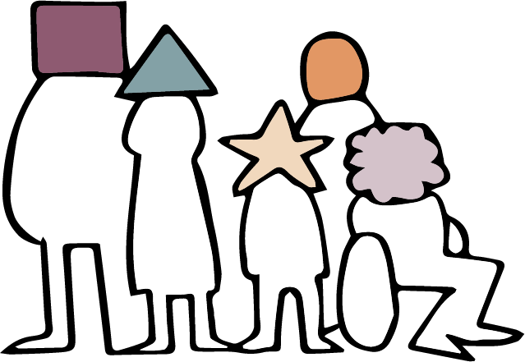
Freedom of religion or belief:
Who or what is protected?
Notes:
Slides 25-46 illustrate the session 2 presentation.
Presentation: Freedom of Thought, Conscience, Religion and Belief Introduction So, who or what does freedom of religion or belief protect?
You might think the logical answer is religions and beliefs. But actually, freedom of religion or belief doesn’t protect religious or other beliefs in themselves. It doesn’t protect God or the sacred. Just like every other human right, it protects people.
To give the right its fullest name, Freedom of thought, conscience, religion and belief protects rights for every human being – no matter who they are, no matter what they believe in or what religion they belong to.

Slide 26
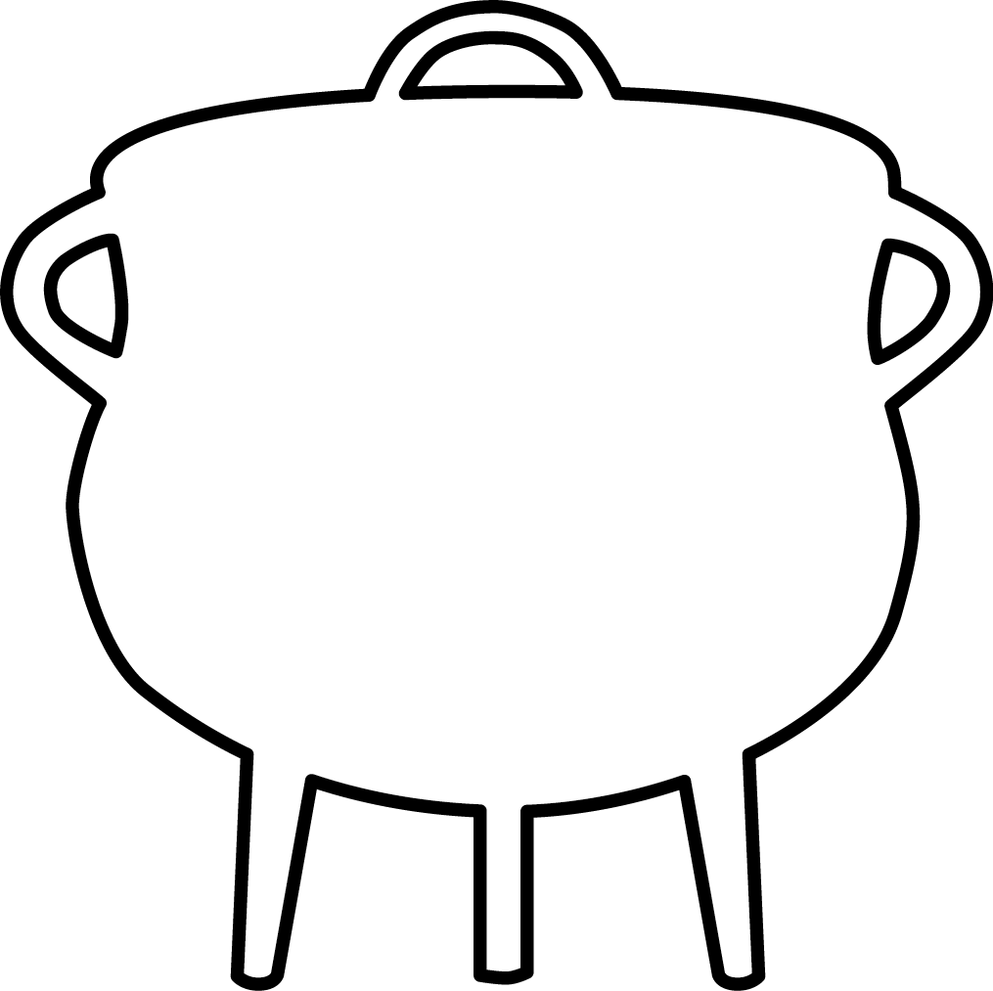
Human needs and
Human rights
Notes:
Freedom of religion or belief is based on the idea that all human beings have fundamental needs:
to be allowed to think and decide for themselves about what is good and true
to belong to groups with shared beliefs, practices and identities
and to be able to question ideas and practices, change their minds about what they believe and refuse to do things which violate their conscience.
To Think, Believe, Belong, Practice, Question, Change their minds and Refuse.

Slide 27
International Covenant on Civil and Political Rights
ICCPR
Notes:
What rights do we have So, what rights do we have? Let’s take a look at what is written in the conventions:
Freedom of religion or belief is protected by Article 18 of the International Covenant on Civil and Political Rights – the ICCPR. This is a legally binding covenant and 173 countries have committed themselves to following these international laws. [Tell participants if your country has agreed to the ICCPR.]

Slide 28
Everyone shall have the right to freedom of thought, conscience and religion.
Article 18
Notes:
The first sentence of Article 18 says:
“Everyone shall have the right to freedom of thought, conscience and religion.”

Slide 29
Think
Notes:
Everyone has the right to think for themselves – like Ziana in the story, who thought she should be allowed to wear the flute even though she was a girl.

Slide 30
Refuse
Notes:
We have the have the right to listen to our conscience – like Brone who refused to help his father because he believed his father’s actions were wrong.

Slide 31
Believe
and belong
Notes:
And we have the right to hold religious or non-religious beliefs and to have a religious or belief identity – to believe and to belong. Just like the flute and drum villagers, many of us hold sincere beliefs. Our beliefs and the community of people we share them with can mean a great deal to us.

Slide 32
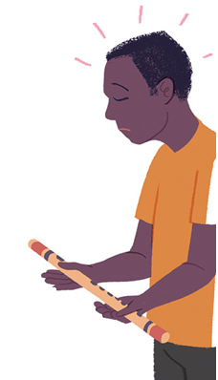
Change
Notes:
But no matter what society we live in or how true and right our beliefs are, there will be people who, for whatever reason, lose faith in their beliefs or in their community – like Brone who took off his flute and left his community.

Slide 33
ICCPR Article 18
This right shall include freedom to have or to adopt a religion or belief of his choice
UDHR Article 18
This right shall include freedom to have or to change his religion or belief
Notes:
In international human rights law, the right to leave and to change your religion or belief is protected alongside the right to have your religion or belief.

Slide 34
Inner freedoms
Notes:
These rights to think, believe, question and change our beliefs are often called inner freedoms. They are about what is happening in our mind and our soul, which relate to our identity – our sense of who we are.
For this reason, they are absolute rights. Under international law, no person or government is allowed to limit these rights, ever.
But of course, religion and belief are about far more than what is happening in our minds and souls! It is about what we do – about how we express our beliefs in words and actions.

Slide 35
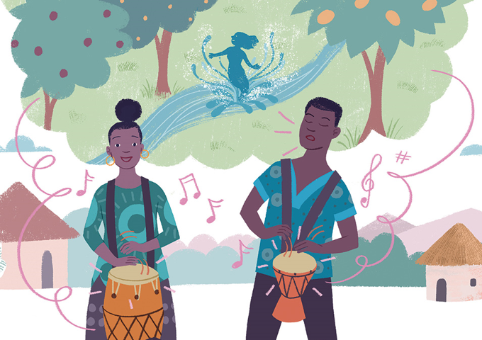
Practice
Notes:
In our story, the lives of the villagers were full of practices that expressed their beliefs and belonging! From the wearing of flutes to the drumming of daily life. Freedom of religion or belief also protects these rights. Let's look at the Covenant again:

Slide 36
This right shall include … freedom, either individually or in community with others and in public or private, to manifest his religion or belief in worship, observance, practice and teaching.
Article 18
Notes:
Article 18 says: This right shall include … freedom, either individually or in community with others and in public or private, to manifest his religion or belief in worship, observance, practice and teaching.
We have the right to pray privately and to express our religion or belief as part of a community, with collective worship and traditions. And that community has rights too – not rights to control their members, but rights in relation to the state. For example, the state has to ensure that religious and belief communities can gain a legal identity if they want to, so that they can hold bank accounts, employ people and own buildings.
There are many different ways for individuals and groups to practice a religion or belief, and United Nations experts have provided plenty of examples of activities that are protected. For example, we have the rights:

Slide 37
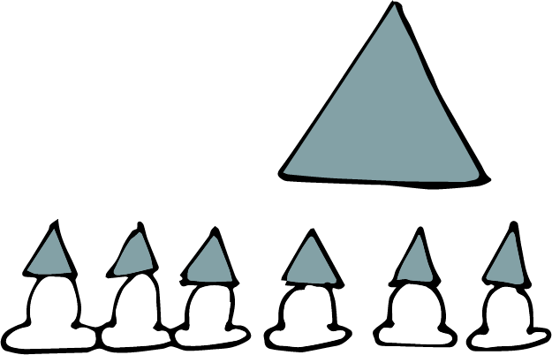
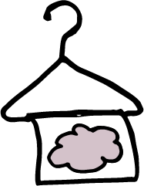
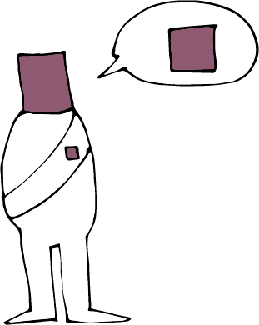
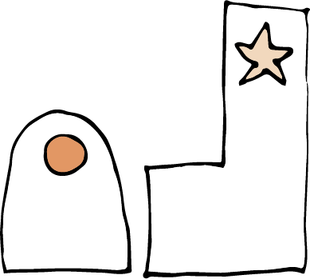
Notes:
To come together for worship, celebrate festivals and observe days of rest.
To wear religious clothing and follow special diets.
To have places of worship, cemeteries and to display religious symbols.
To play a role in society, for example by forming charitable organisations and
To talk about and teach religion or belief, and train or appoint leaders.
At this point, you might be thinking, “Great – these are just the kind of rights I want for my community!” Or you might be getting worried!

Slide 38
Notes:
Voluntarism and Equality – Do not harm others!
What about people or groups who use their religion or belief to promote hatred or violence towards others, who discriminate against others or who repress and control others within their group?
Does Freedom of Religion or Belief mean that they free to do this – no matter what the impact on other people?
Thankfully not!

Slide 39
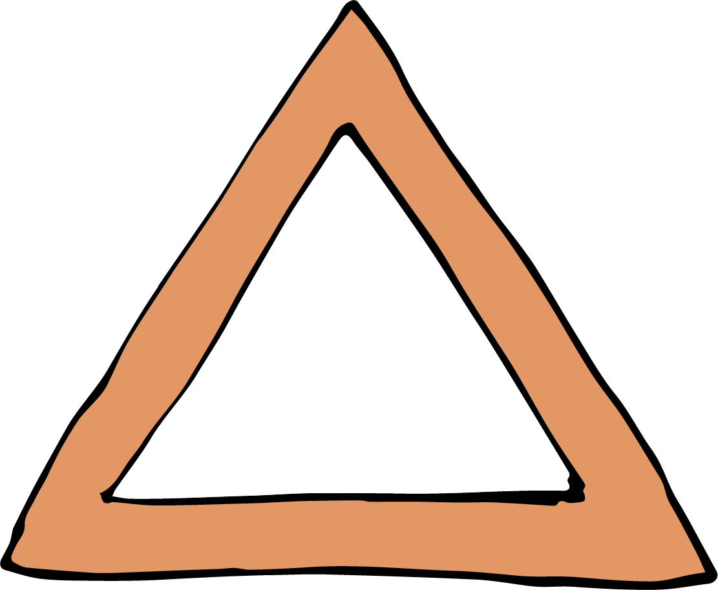
Human responsibilities
Notes:
Human rights conventions tell us both what our rights are and what the limits to our rights are. Or to put it another way – what our responsibilities are when we exercise our rights.
We can sum these responsibilities up by saying that no one should use their rights and freedoms in ways that harm other people. This is every person’s moral duty according to human rights conventions.
And the government has a legal duty to respect everyone’s rights and to protect everyone from harm.
Let’s look more specifically at HOW we should be protected from harm.

Slide 40
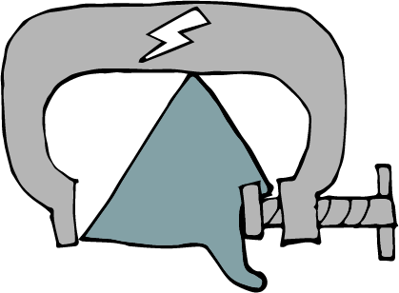
Coercion is not allowed.
Article 18
Notes:
Firstly: No coercion! Coercion is not allowed in matters of religion or belief. Believing and belonging are voluntary.
The authorities, faith communities and families are NOT allowed to use threats, intimidation or violence to force anyone to believe or not to believe, to practice or not to practice, to belong to a religion or not belong to a religion.

Slide 41
Discrimination is
not allowed.
Article 2
Notes:
Secondly: No discrimination! Article 2 of the Covenant bans discrimination of any kind – whether it is based on religion, race, gender or language for example. States that have signed human rights treaties have agreed to treat everyone equally and to work actively to end discrimination in society – like the market council did in our story.

Slide 42
No-one may use one right to destroy other human rights.
Article 5
Notes:
Thirdly: No destroying of rights! Article 5 states that no government, group or person is allowed to interpret one human right as giving them the right to act in a way that destroys other human rights.
And Article 20 prohibits advocating religious hatred through incitement to discrimination, hostility or violence.
Regardless of what a government or a person thinks that a religion requires of them, no one can argue that freedom of religion or belief gives them the right to trample on other peoples’ rights. So Brone’s father had no right to harass the drummers, even if he thought it was the right thing to do.
I’m sure you can think of plenty of examples of religion being used to justify or incite violence, or of religious practices that harm people. You might also be able to think of times when people are unjustly prevented from peacefully practicing their religion or belief.

Slide 43
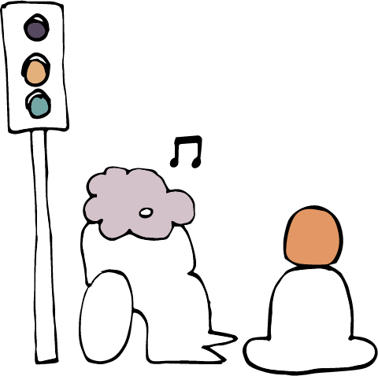
No limitations!
Limitations?
Notes:
Limitations to freedom of religion or belief
So, what are the rules? When are governments allowed to limit freedom of religion or belief? Let’s take a quick look at the rules.
Firstly, the right to think and believe (the inner freedom) may never be limited.
Secondly, the practice of religion or belief may be limited – but ONLY when the following four rules are followed.

Slide 44
Limitations must be:
Written in law
Proportionate
Non-discriminatory
Necessary to protect public health, public order, public safety, public morals or the rights and freedoms of other people
Notes:
There has to be a LAW describing the limitation. In other words, the police can’t just do what they like.
The limitation has to be PROPORTIONATE to the problem it is trying to solve. For example, if the speaker system of a faith community is too loud, the faith community may be ordered to turn it down or face a fine. Banning them from meeting altogether would not be proportionate.
All limitations have to be NON-DISCRIMINATORY – they have to apply to everyone.
The limitation has to be NECESSARY to PROTECT one of the following things: Public safety, public order, public health, public morals or the rights and freedom of other people.
The word necessary is really important. It is not enough that the government or the majority of the population think the limitation is desirable to achieve these goals. The limitation has to be necessary. In other words, there should be no way of solving the problem created by the practices without limiting rights. Limiting rights is meant to be a last resort. None the less, it is sometimes necessary.

Slide 45
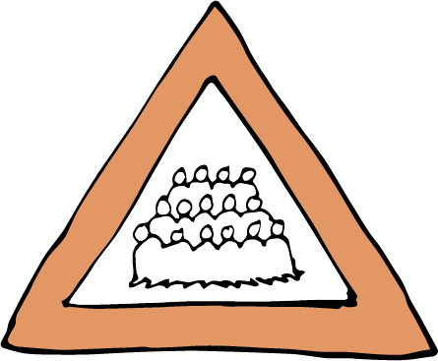
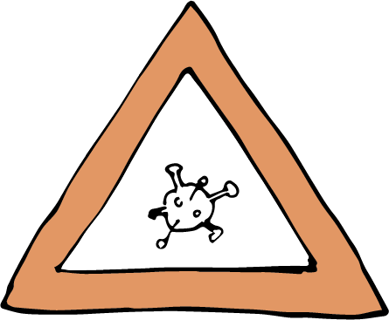
Legitimate limitations
Notes:
For example, it can be dangerous to cram too many people into a place of worship. So, it may be necessary for the authorities to limit the number of people allowed in a place of worship on the grounds of public safety.
Public health restrictions on gatherings for worship have been very common during the Corona virus pandemic – sometimes these restrictions have been necessary, proportionate and non-discriminatory. Sometimes they have been highly discriminatory and disproportionate.
Bans on female genital mutilation are an example of a limitation that protects the rights and freedoms of others – in this case girls. Regardless of whether this is seen as a cultural or religious practice, it is endangers the health of girls and cannot be justified with reference to freedom of religion or belief.

Slide 46
Limitations must be:
Written in law
Proportionate
Non-discriminatory
Necessary to protect public health, public order, public safety, public morals or the rights and freedoms of other people
Notes:
These rules are really important. Without them, governments could limit any and every group or practice that they don’t happen to like. Limitations are meant to be a last resort, not a tool for state control. In the coming sessions, we are going to be looking in more depth at the different kinds of violations of freedom of religion or belief that happen around the world.

Slide 47
NOTE: You may wish to add one or more slides here about what the law in your country says about FORB.
Notes:
NOTE: You may wish to add one or more slides here about what the law in your country says about FORB.

Slide 48
Photo: Robbi Akbari Kamaruddin / Alamy Stock Photo
Notes:
Slides 48-60 relate to the FORB in our day exercise. Use them while reading the text in the speakers notes or saying something similar.
Think about a typical day in your life.
(Muslim man performing ablutions before prayer, Indonesia)

Slide 49
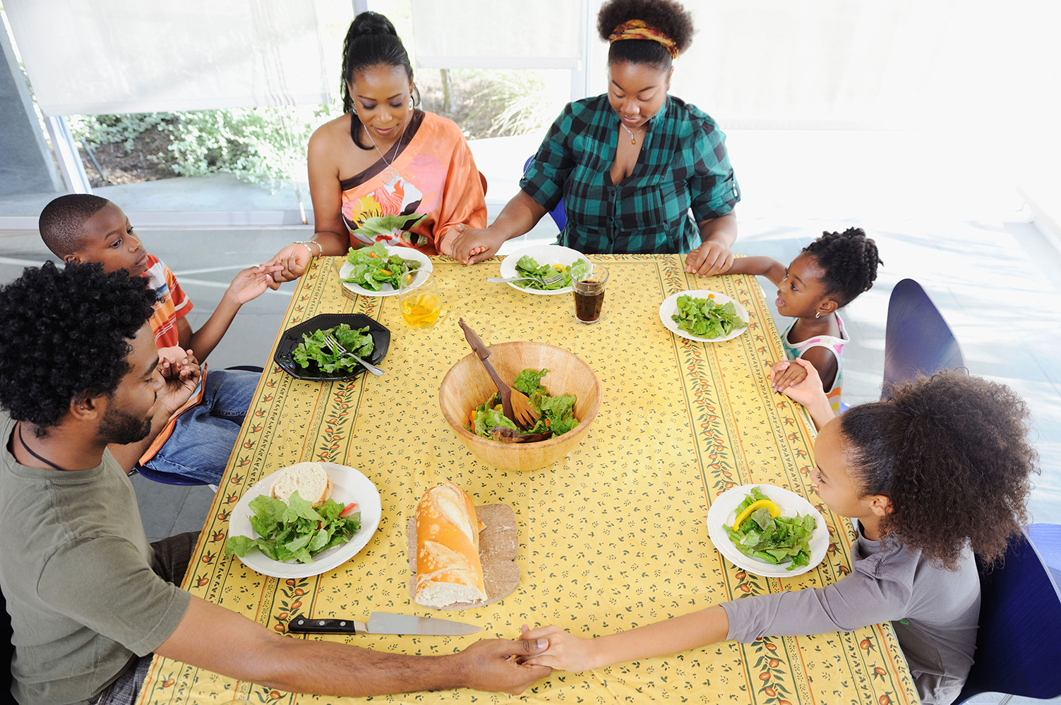
Photo: Tetra Images, LLC / Alamy Stock Photo
Notes:
When and how do you express your thoughts, beliefs, questions...
(Christian family say grace before a meal, USA)

Slide 50
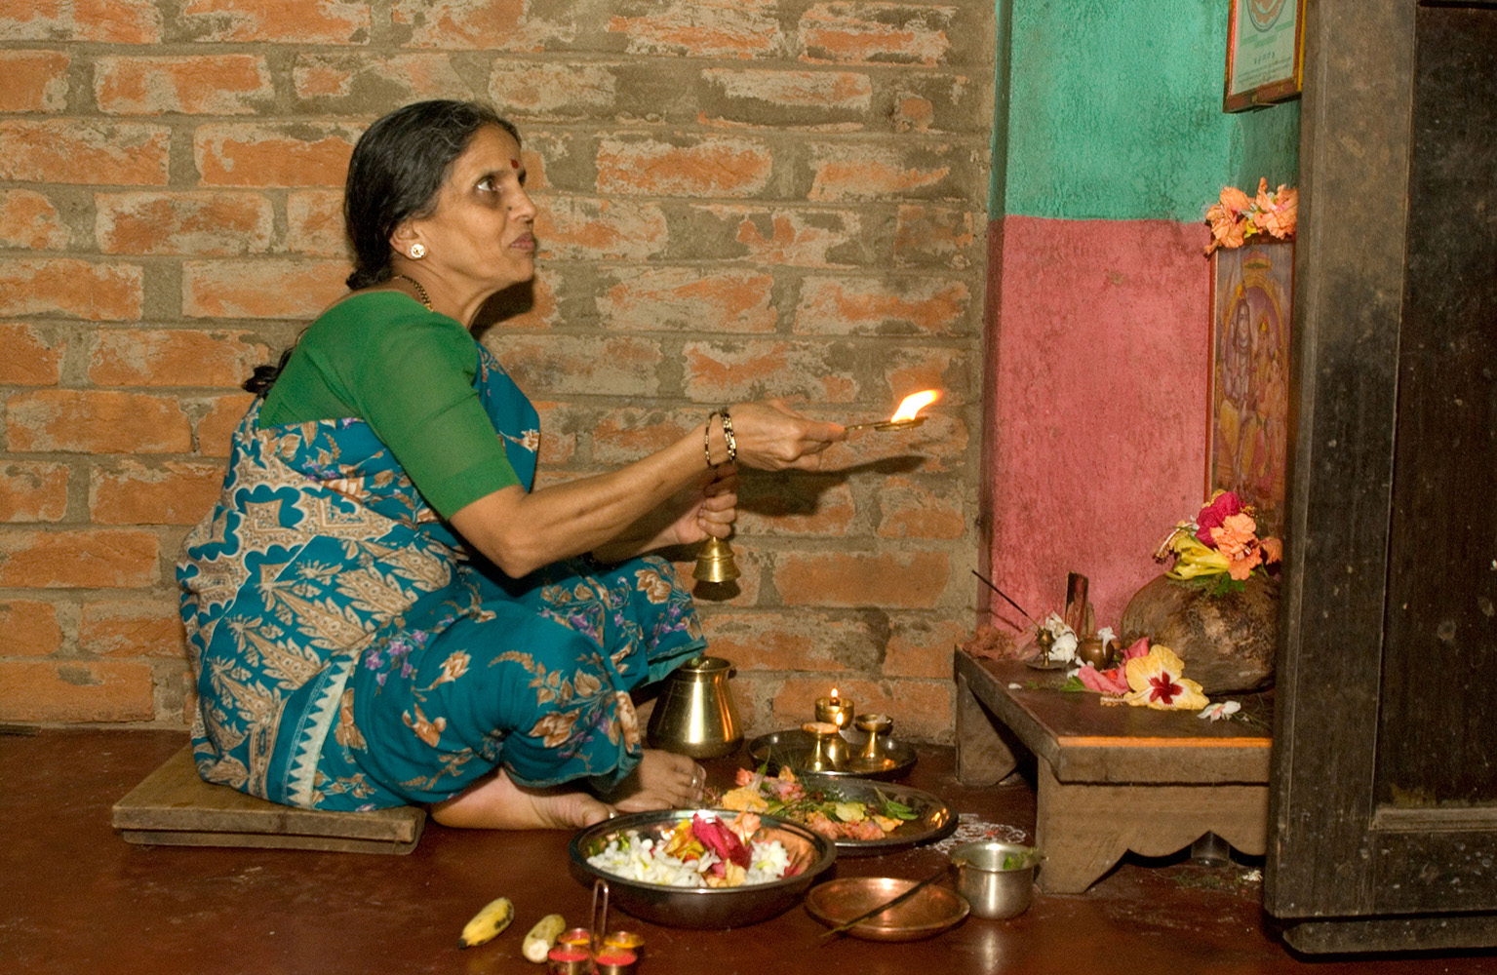
Photo: Simon Rawles / Alamy Stock Photo
Notes:
and your sense of religious or non-religious belonging and identity?
(Hindu woman prays at her home shrine, India)

Slide 51
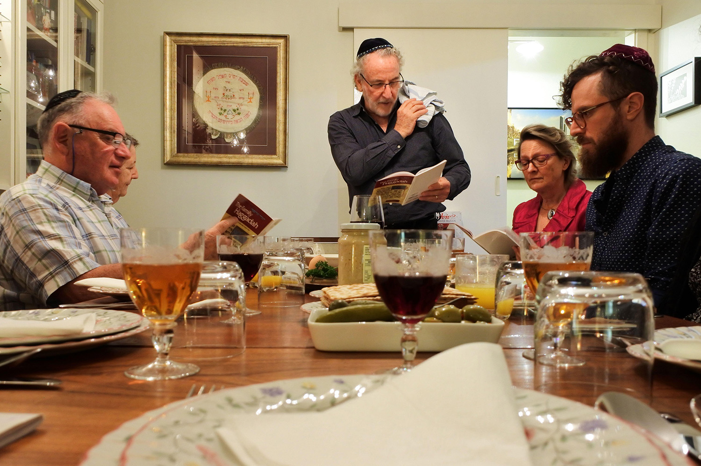
Photo: Rafael Ben Ari / Alamy Stock Photo
Notes:
It could be in the things you eat...
(Jewish family Passover meal, Australia)

Slide 52
Photo: Gregory Wrona / Alamy Stock Photo
Notes:
...or don’t eat.
(Halal butchers, London)

Slide 53
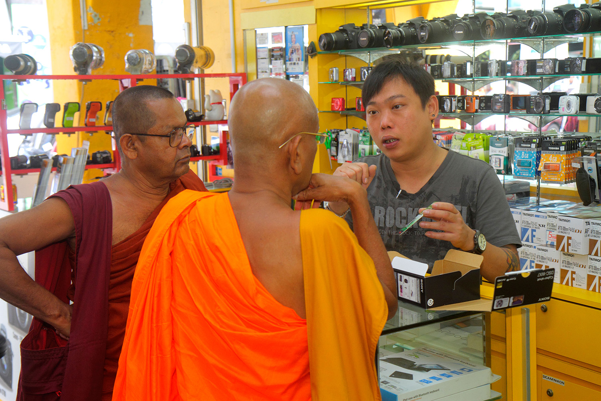
Photo: Jeffrey Isaaz Greenberg / Alamy Stock Photo
Notes:
In what you wear, or don’t wear.
(Buddhist monks shopping, Singapore)

Slide 54
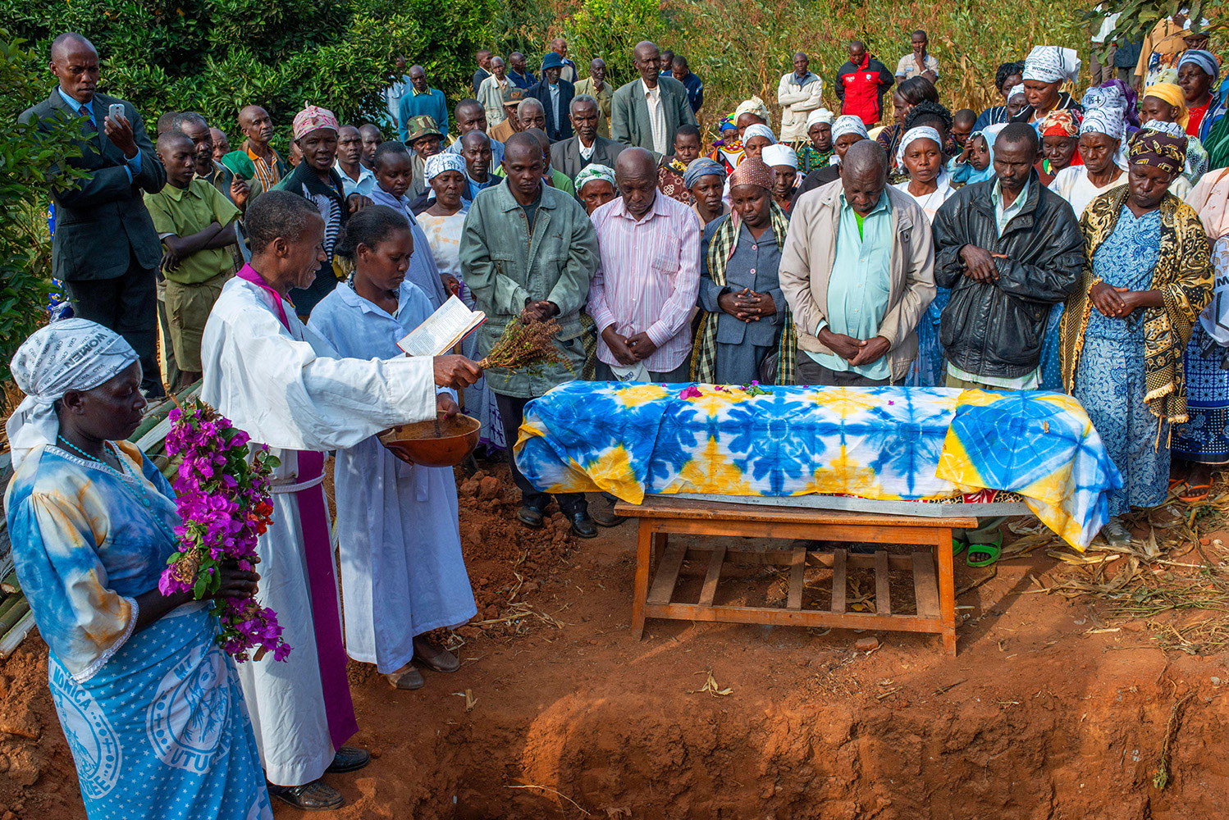
Photo: Sergi Reboredo / Alamy Stock Photo
Notes:
In prayers or rituals...
(Funeral for a victim of COVID and AIDS, Kenya)

Slide 55
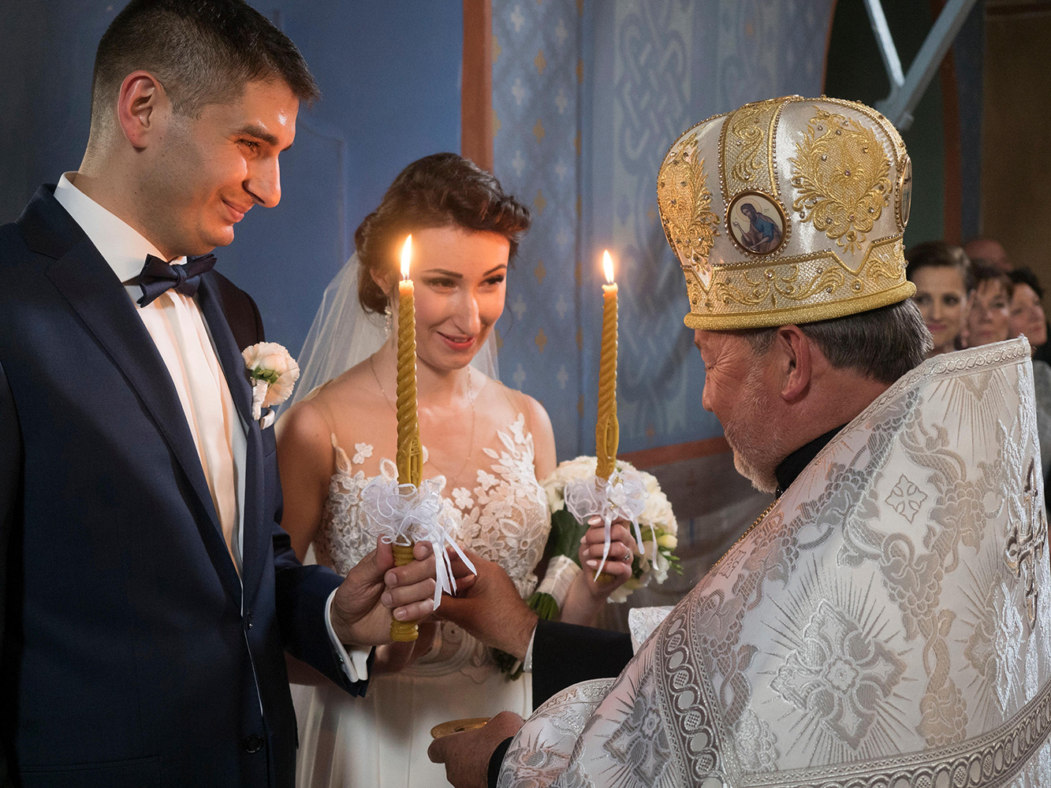
Photo: Agefotostock / Alamy Stock Photo
Notes:
...or celebrations of key moments in life.
(Orthodox Christian wedding, Poland)

Slide 56
Photo: Dieddin Alsoub / Alamy Stock Photo
Notes:
In what you read.
(Muslim family discussing books)

Slide 57
Photo: Skynesher/Istock
Notes:
In conversations you have with your family, friends or colleagues.
(Colleagues arguing)

Slide 58
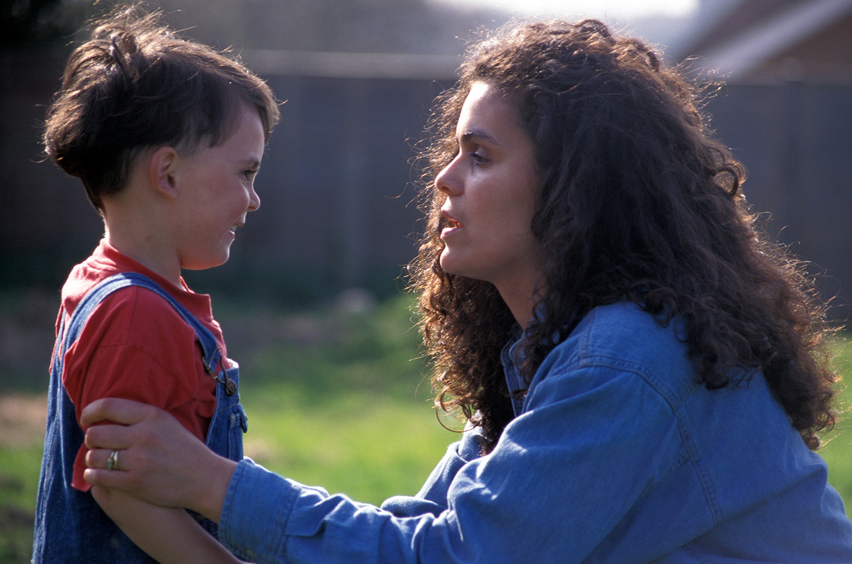
Photo: Angela Hampton Picture Library / Alamy Stock Photo
Notes:
And how you bring your kids up.
(Mother telling off child)

Slide 59
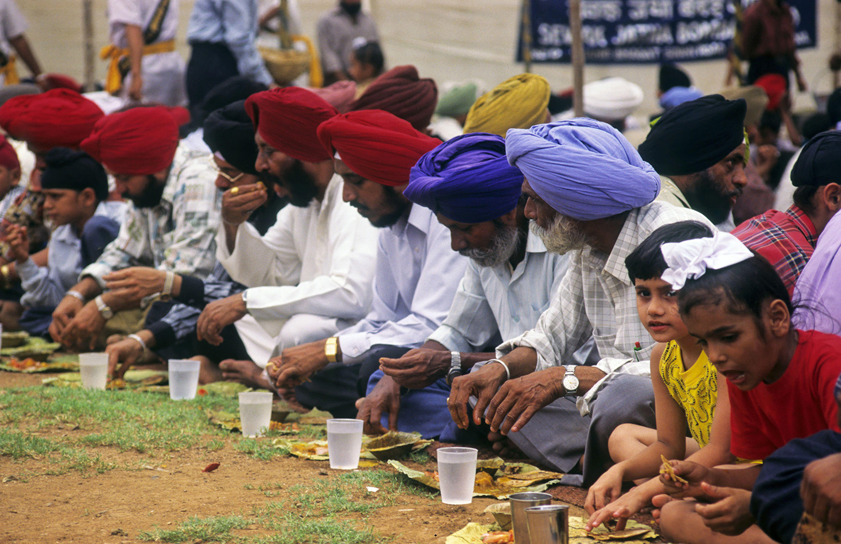
Photo: Dinodia Photos / Alamy Stock Photo
Notes:
In how you serve the community...
(Sikh community kitchen, India)

Slide 60
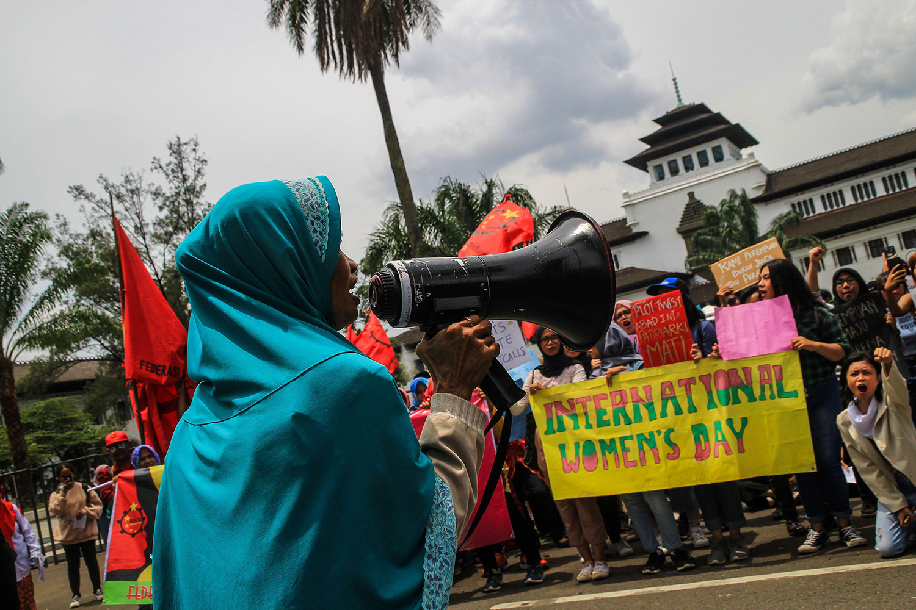
Photo: SOPA Images Limited / Alamy Stock Photo
Notes:
Or engage with issues that concern you in society.
(Protest for women’s rights, Indonesia)

Slide 61
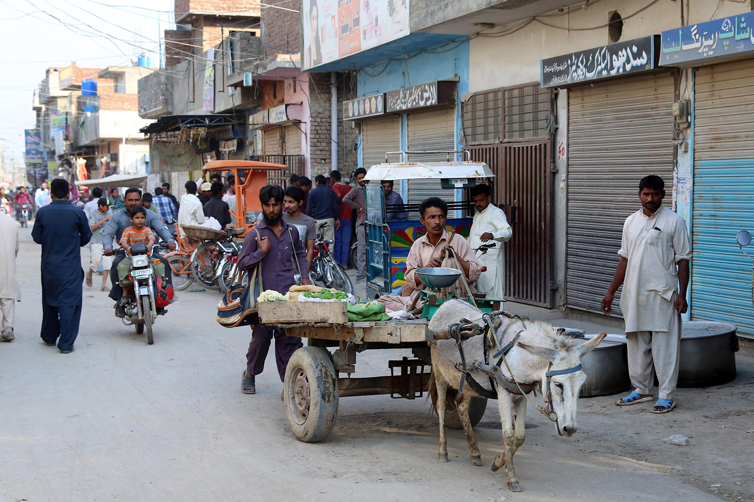
Photo: Friedrich Stark / Alamy Stock Photo
Notes:
Slides 61-63 illustrate Peter’s story, used for the concluding comments of the session.
Peter’s story, Pakistan
Peter is a young man who helped make a difference for a community of Christians in Kot Lakhpat, a predominantly Muslim area in the city of Lahore, Pakistan. Every morning, Peter starts his day watching a service presented by a pastor on a local Christian TV station. “I don’t have much time to read scriptures or take part in bible study groups but watching this service is a wonderful way for me to start my day,” he says.

Slide 62
Photo: Simon Mayer
Notes:
One morning, the Christian TV channel went off air. At first, Peter assumed there was a technical problem. When the channel was still off the air a week later, Peter and a group of regular viewers from the area approached the TV pastor, who told them that the channel was working fine in other areas.
Looking into it, they discovered that an imam at a local mosque had arranged with the cable technician to cut off the channel in the area, because a local maulvi (religious scholar) considered it to be Christian evangelism.
“You can imagine how surprised we were. We live closely with our Muslim neighbours and we don’t have problems with them.” said Peter.

Slide 63
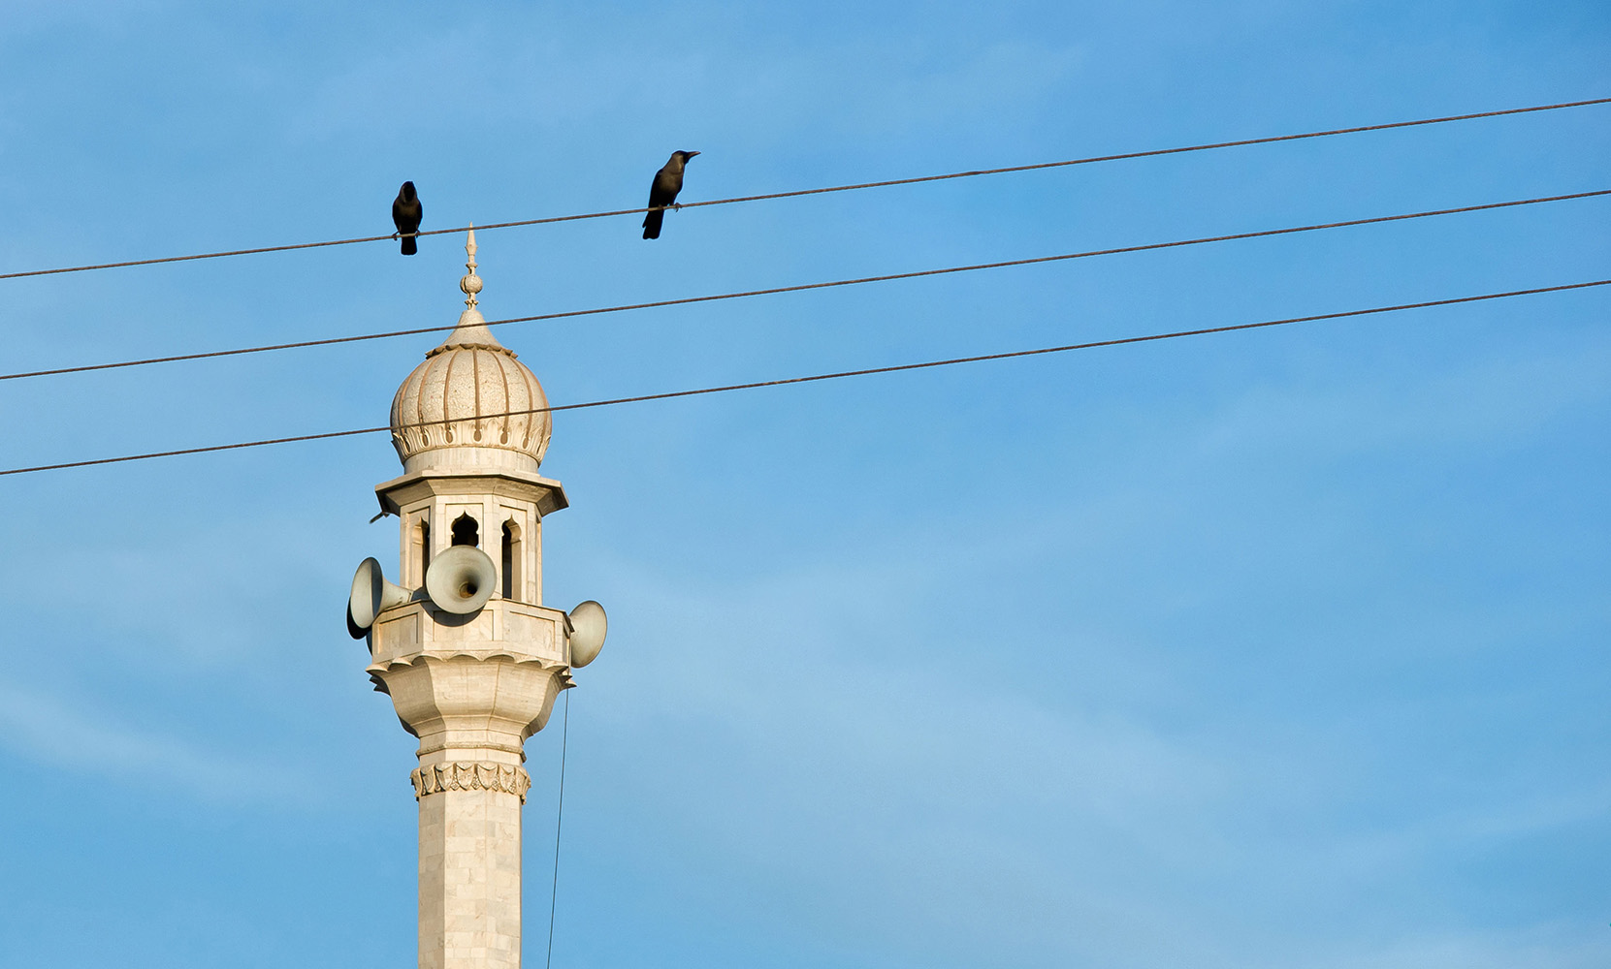
Photo: Agencja Fotograficzna Caro / Alamy Stock Photo
Notes:
The group knew the situation was sensitive, so they contacted a national ecumenical organisation for advice and information. Following this advice, they first met with the cable technician. He had no objection to connecting the broadcast but said he couldn’t go against the imam. The group decided that they needed a dialogue with the maulvi.
A representative of the group spent over three hours trying to convince him to allow the channel to be aired, with no success. The next day, the representative tried again and told the maulvi about human rights, freedom of religion and belief and the rights given to each citizen by the Constitution of Pakistan. After a long day of reasoning, the maulvi agreed to allow the channel to be aired, but requested that Christian viewers keep the volume down during Muslim prayer times so as not to disturb neighbours at prayer.
“We were so happy!” Peter says, “Even though it’s just a TV broadcast for some people, it is a very important part of our lives as Christians”.

Slide 64
Well done and welcome back!
Next session: Our many identities

